Slide 1
The Contribution of AFBI Science to the Northern Ireland bTB Programme
Roly Harwood Senior Principal Veterinary Officer
Veterinary Service and Animal Health Group
DAERA

Slide 2
A bTB programme perspective on the science provided by AFBI
The programme
The problem
The need for science
What has been delivered and how is it used
Looking forward

Slide 3
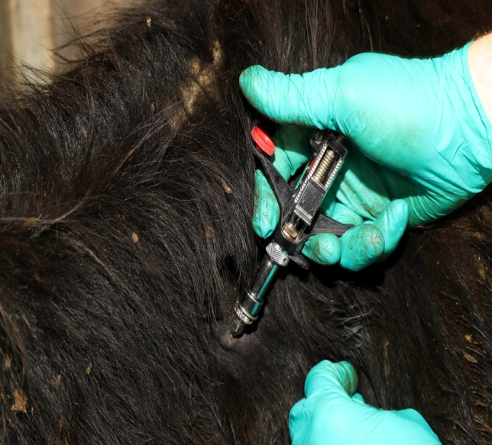
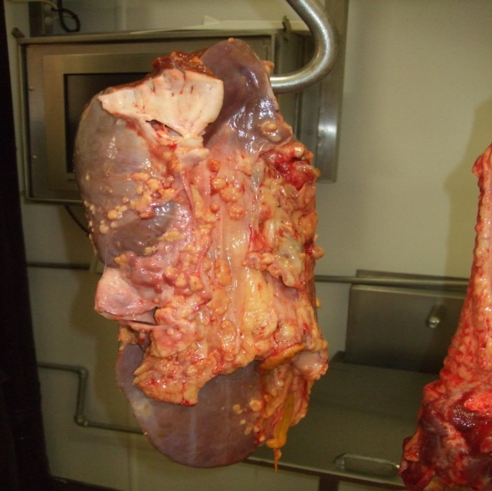
The bTB Programme
Detection of infection by live animal or post mortem surveillance
Live animal surveillance employs the skin test and the gamma interferon blood test
PM examination conducted on every animal slaughtered for human consumption
Removal of infected and/or exposed animals
Controls applied to breakdown herd
Tracing and risk assessments lead to further testing in other herds
Approved by EU for co-funding
Programme costs in excess of £30 million annually

Slide 4
The Problem
The programme is not resulting in a reduction in disease levels
FVO 2015 – “...but the herd incidence rate has stagnated at levels above 6%, which is not what would be expected with an effective eradication programme in place.”
Current herd incidence – 8.23%. Highest since 2005.
Reactor numbers in 2016 highest since 2004
Many factors influencing spread of infection
Much is still not understood
Our tool box is limited

Slide 5
The need for science
Essential for programme development
Identify and fill knowledge gaps
Support evidence based policy making
Development of economic assessments
Important for acceptance of the programme
Enabling best use of available tools
Horizon scanning and new technologies
Input to the day to day running of the programme
Scientific advice – queries and problem solving

Slide 6
The need for science
There is no silver bullet
Competing with other programmes for funding
Large scale projects are limited
Research therefore needs to be focussed
Collaborative working
Need objectivity and independence
Accept that some questions cannot be answered
But there is still a lot that can be done

Slide 7
AFBI Contribution
Programme Support/Statutory
Histology
Bacteriology
IFNG blood testing
Post mortem examinations
Forensic pathology
DNA testing
Molecular strain typing
Badger Road Traffic Accident Survey
Expert opinion and advice
Project/Governance Groups

Slide 8
AFBI Contribution
Specific projects
Literature Reviews – slurry spreading; cattle to cattle transmission; badger to cattle transmission; bTB tests; bTB tests in badgers; International application of the Gamma Interferon test
TB Biosecurity Study
Badger Cattle Proximity Study
Gamma interferon Project
Badger Sett Survey
Analysis of Molecular Strain typing
Contribution to the Test, Vaccinate, Remove (TVR) wildlife intervention research
TB Strategic Partnership Group

Slide 9
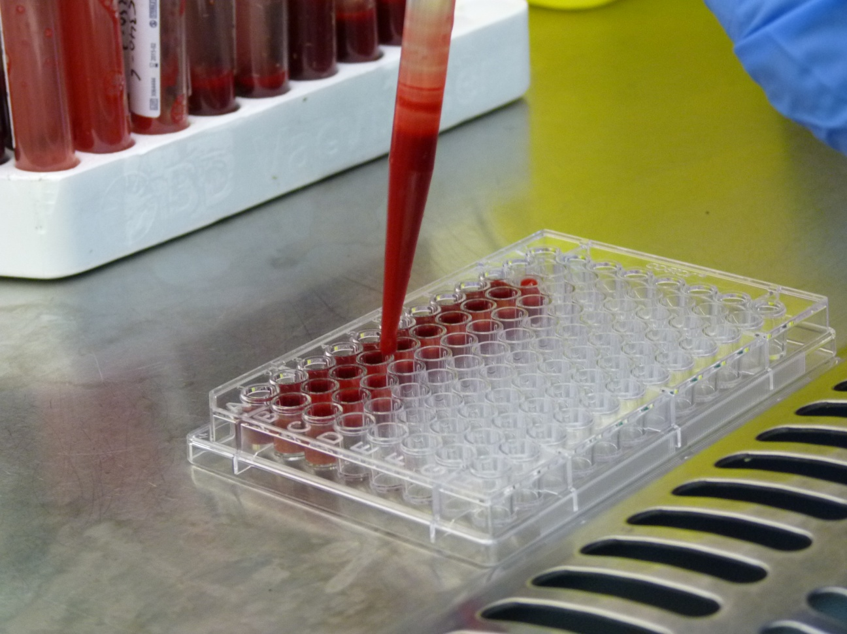
AFBI Contribution
Evaluation of multiple reactor and chronic breakdown herds
TB transmission dynamics using genome epidemiology
Role of endemic diseases and other factors
Resuscitation promotion factors enhanced culture
Optimisation and enhancement of the test format for gamma interferon
Improve reliability of genomic prediction
bTB molecular epidemiology – analysis of cattle movements and optimisation of epidemiological investigations

Slide 10
FVO 2015
“A comprehensive and well-targeted research agenda has provided the competent authorities with relevant evidence to reinforce the implementation of the available control and eradication measures.”

Slide 11
Going forward
The TBSPG report will provide the basis for the way forward
There will be a continuing need for AFBI scientific input
Much of the work already completed/underway will play a big part. For example Gamma Interferon, TVR, wildlife, molecular strain typing, herd health management (biosecurity), genomic prediction, research, chronic herds
We will need to use data, evidence and advice to plan and to develop the eradication strategy on track

Slide 12
Extract from the Scientific Peer Review of TBSPG recommendations (Prof Simon More UCD)
...Throughout this collaborative process, scientists and policy-makers have important, but differing, roles:
The role of scientists is to generate information to support policy decision making. It is critical, as highlighted previously, that this information is independent, of high quality, relevant and timely.
b. The role of policy-makers is to maximise returns from scientific effort, by prioritising research needs, helping scientists to clearly understand the research context, by aligning research objectives with these needs, by facilitating collaboration and communications, etc.

Slide 13
Make the programme different and make a difference to the outcome
Thank you

