Slide 1

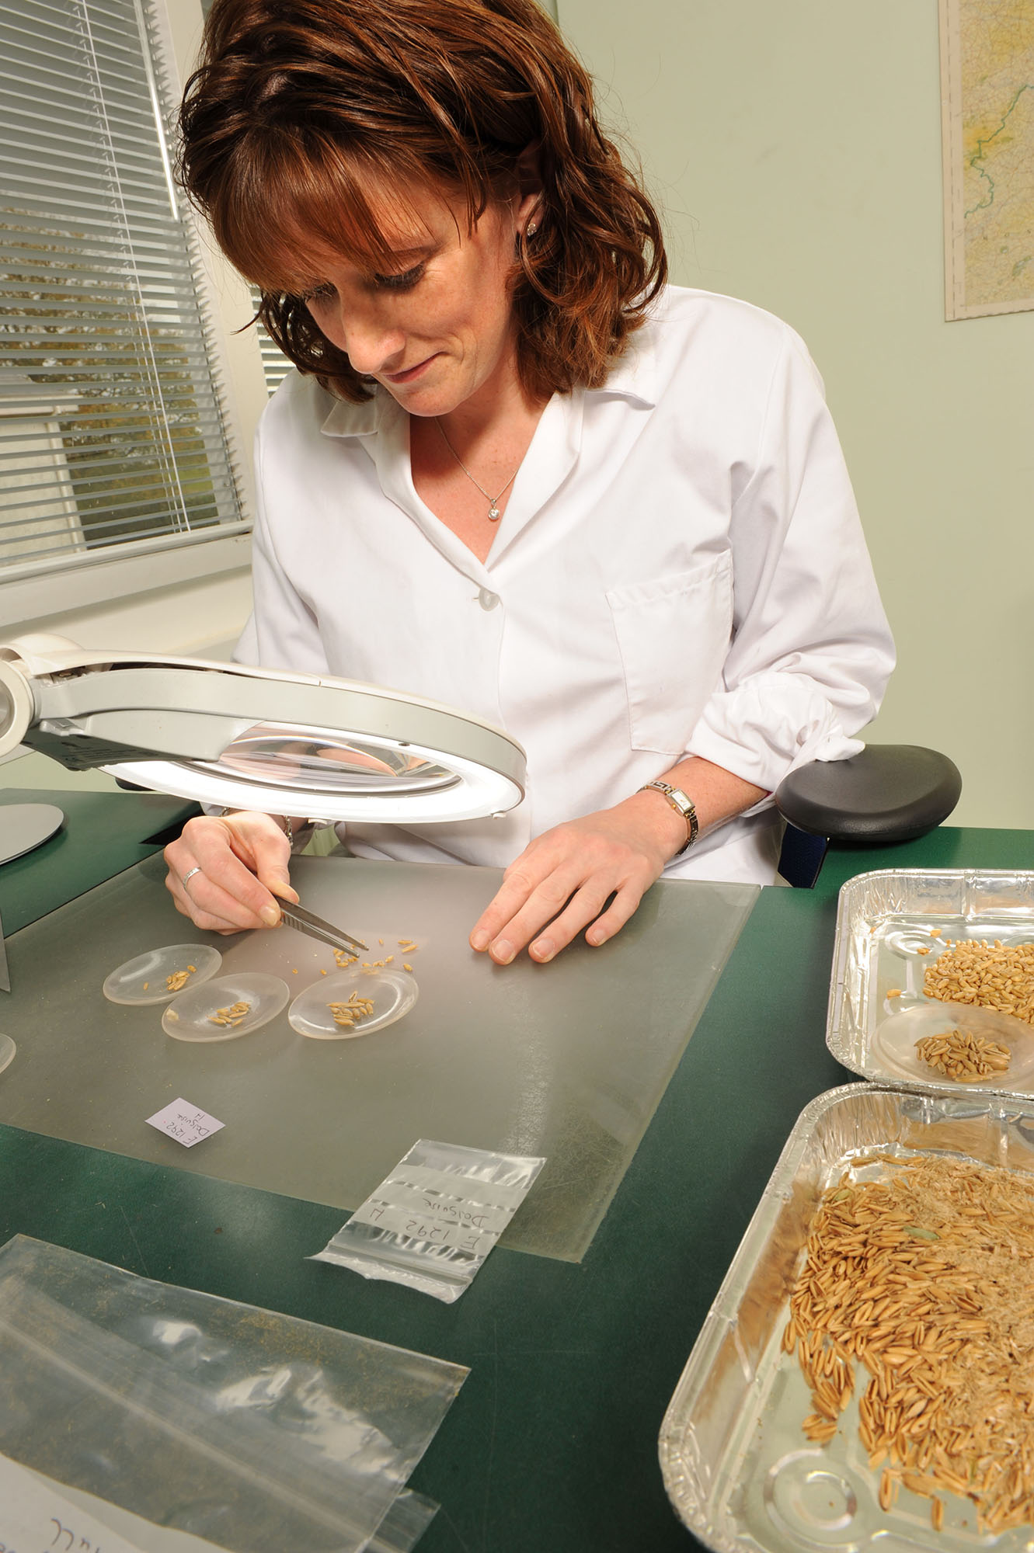
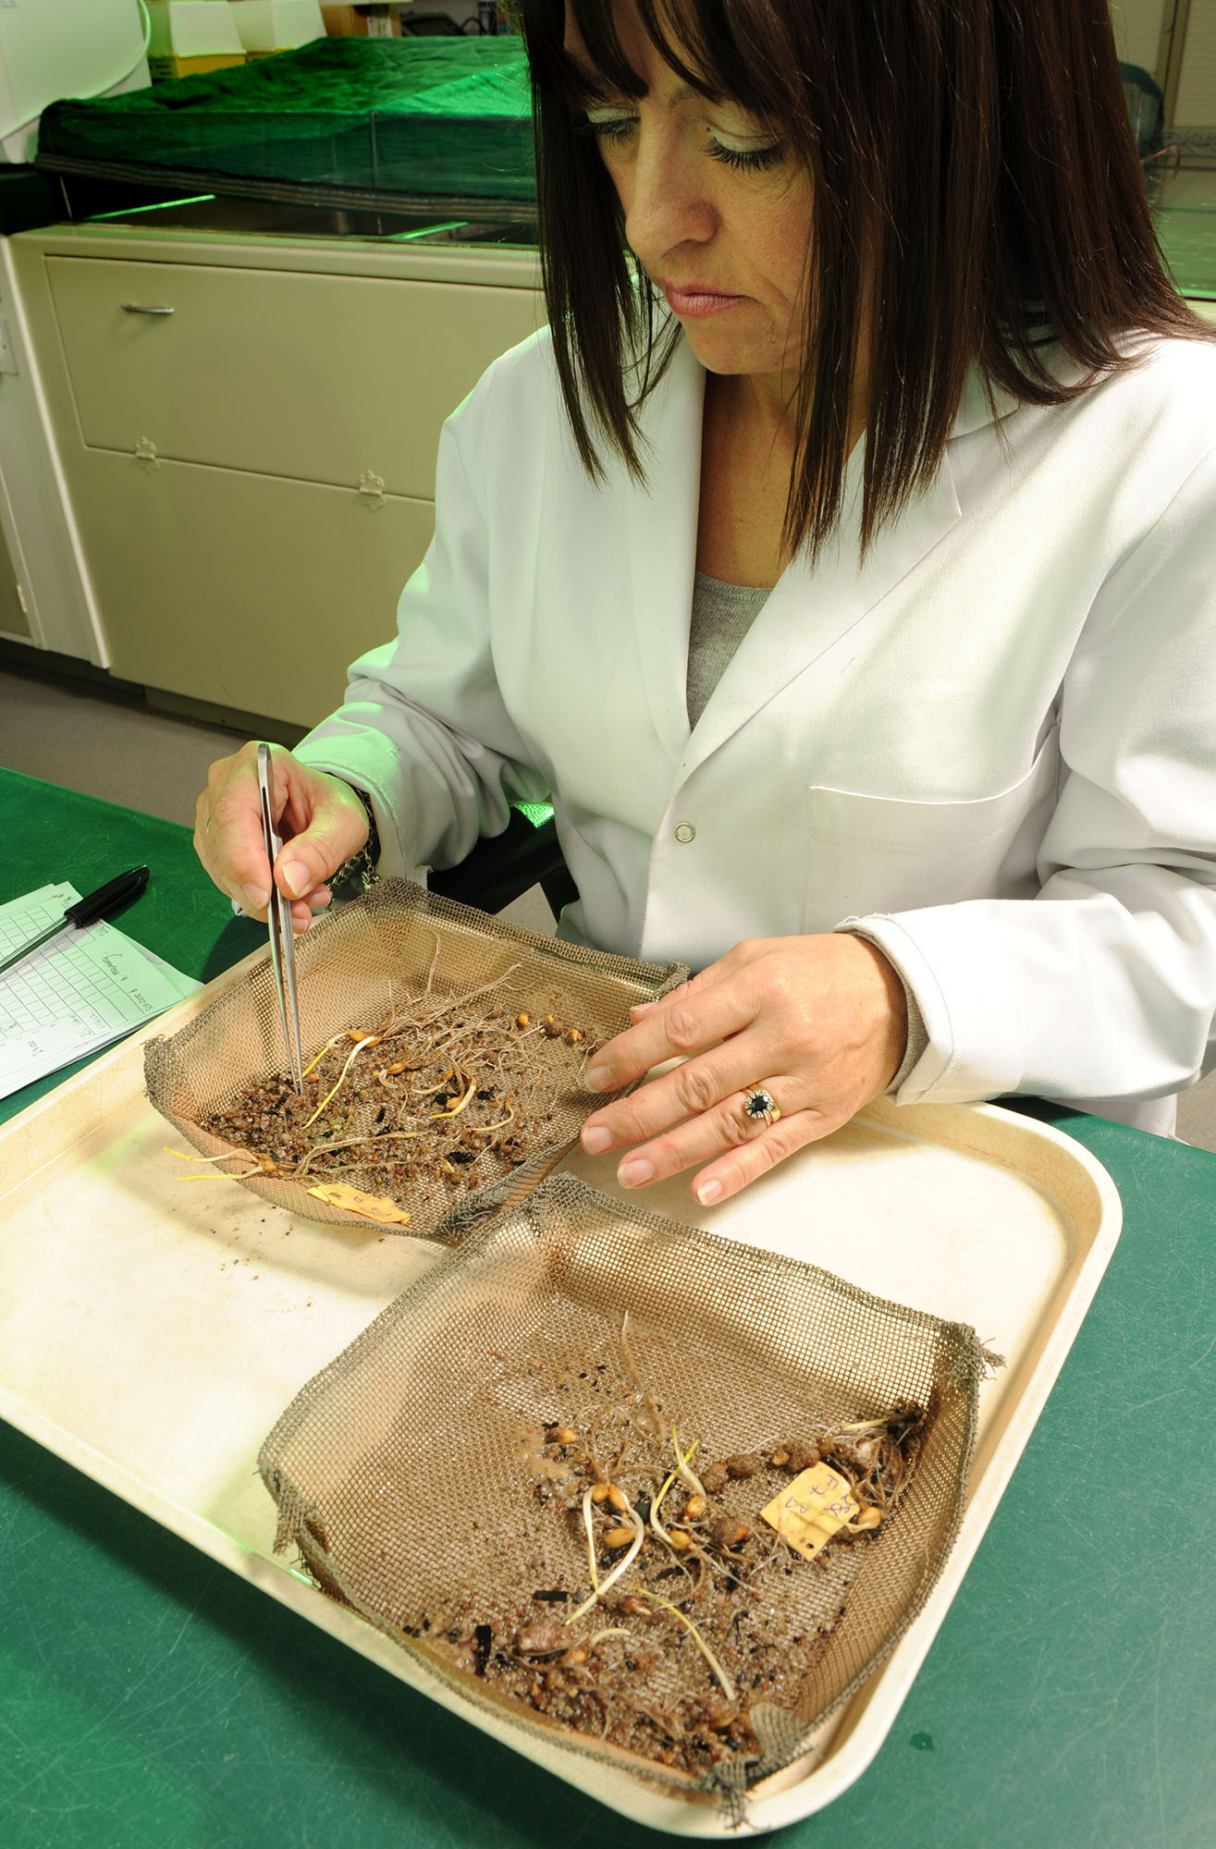

Seed quality assurance in Northern Ireland
Ethel White & Linda Childs
Sustainable Agri-Food Sciences Division, Official Seed Testing Station (OSTS),
AFBI Crossnacreevy
Seed is one of the most important yet potentially variable of all the raw materials used in agriculture. Successful establishment of vigorous cereal crops of chosen varieties requires seed of proven quality.
DAERA’s NI Seed Regulations 2016 are implemented by the Official Seed Testing Station (OSTS) based at AFBI Crossnacreevy.
Provision of quality, i.e. Certified, cereal seed involves and requires:
Appropriate management of the crops being grown to produce seed by the registered grower
Processing, i.e. cleaning of, and application of seed agrochemical treatments to, the harvested seed by the seed merchant
Inspection of the growing crop twice (usually) by the OSTS team or DAERA Inspectors for:
  Confirmation of the variety
  Detection of:
    Varietal and species impurities
    Wild oats and other noxious weeds
    Loose smut
Testing of the seed at the OSTS during and after processing for:
  Germination and purity
Certified cereal seed grown in Northern Ireland and available from local seed merchants meets the following standards:
 | C2 Minimum | C2 HVS Higher Voluntary Standard
Germination | 85% | 85%
Analytical purity | 98% | 99%
No. of weed seeds in 500g (Minimum), 1000g (HVS) | 10 | 4
No. of wild oat seeds | 0 | 0
Low levels of noxious weeds and ergot
Farmers can save and sow their own seed (Farm-Saved Seed, FSS). Royalties on FSS have to be paid to the BSPB (www.bspb.co.uk/farmsavedseed/combinable-crops.php )
It is desirable to check the quality of this seed for:
  Germination
  Presence of wild oats
These tests cost £21 (inc. VAT) per sample and take up to 2-3 weeks (depending on dormancy). A rapid result on viability using the Tetrazolium test can also be obtained (£35.75 inc. VAT per sample) at the OSTS.
Conclusion:
Certified seed of known varieties with high germination and largely free of weed seeds and other matter ensure that crops sown in Northern Ireland establish well and maximally contribute to profitable and sustainable yields.
For further information please contact your CAFRE Development officer, the OSTS at AFBI Crossnacreevy Ph: 02890 548000 or DAERA seed certification Ph: 02890 524406

