Slide 1

Fish stock Assessment Data to Inform Fishing Quotas
Dr. Mathieu Lundy
Fisheries and Aquatic Ecosystems Branch
Notes:
Note: Do not change background, font or font colours.

Slide 2
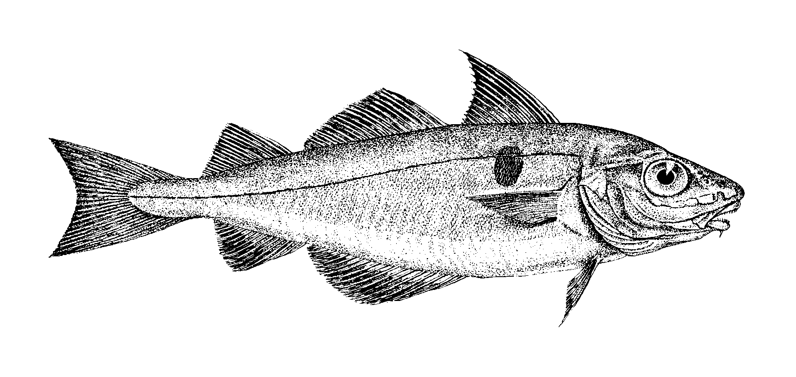
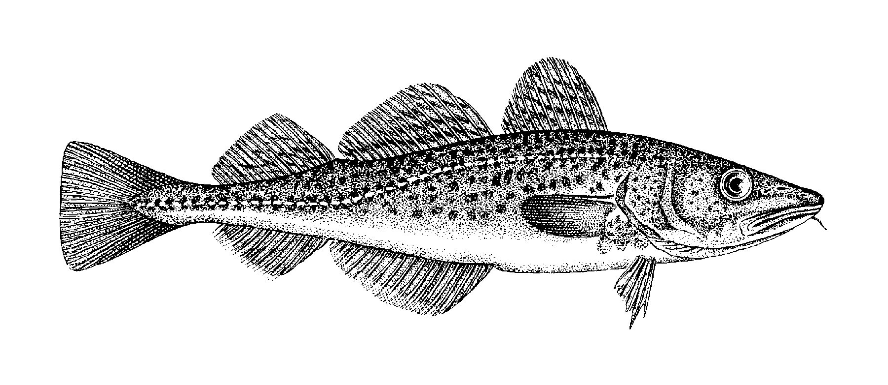
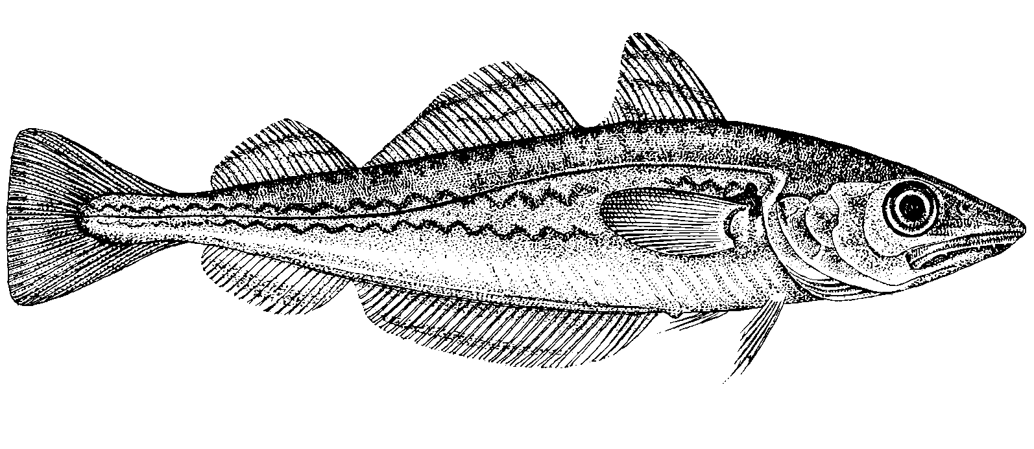
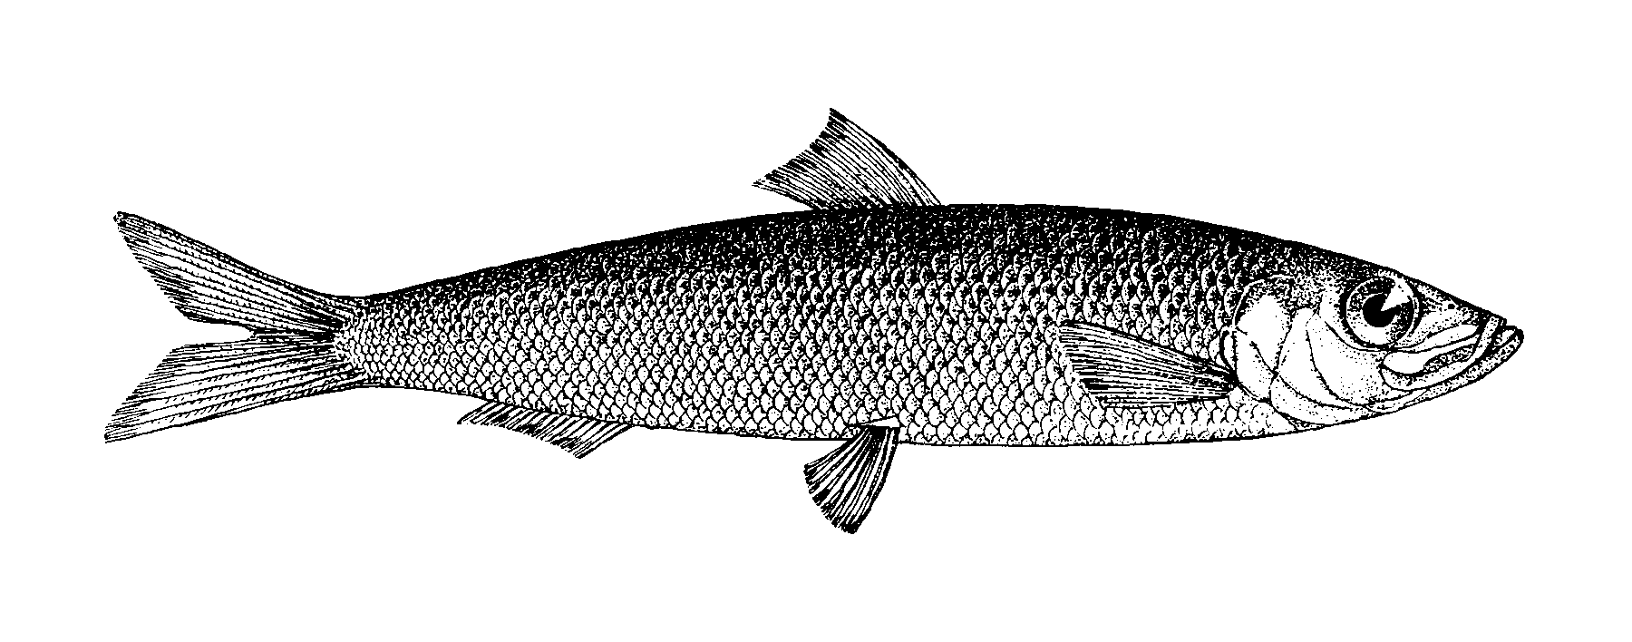
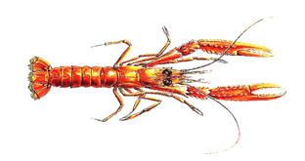
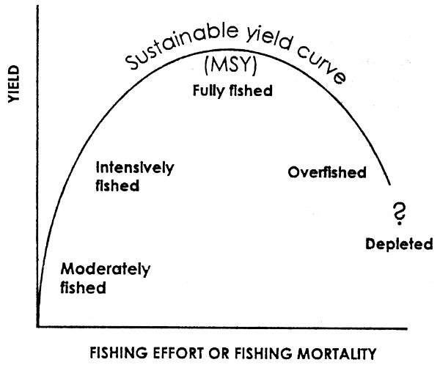
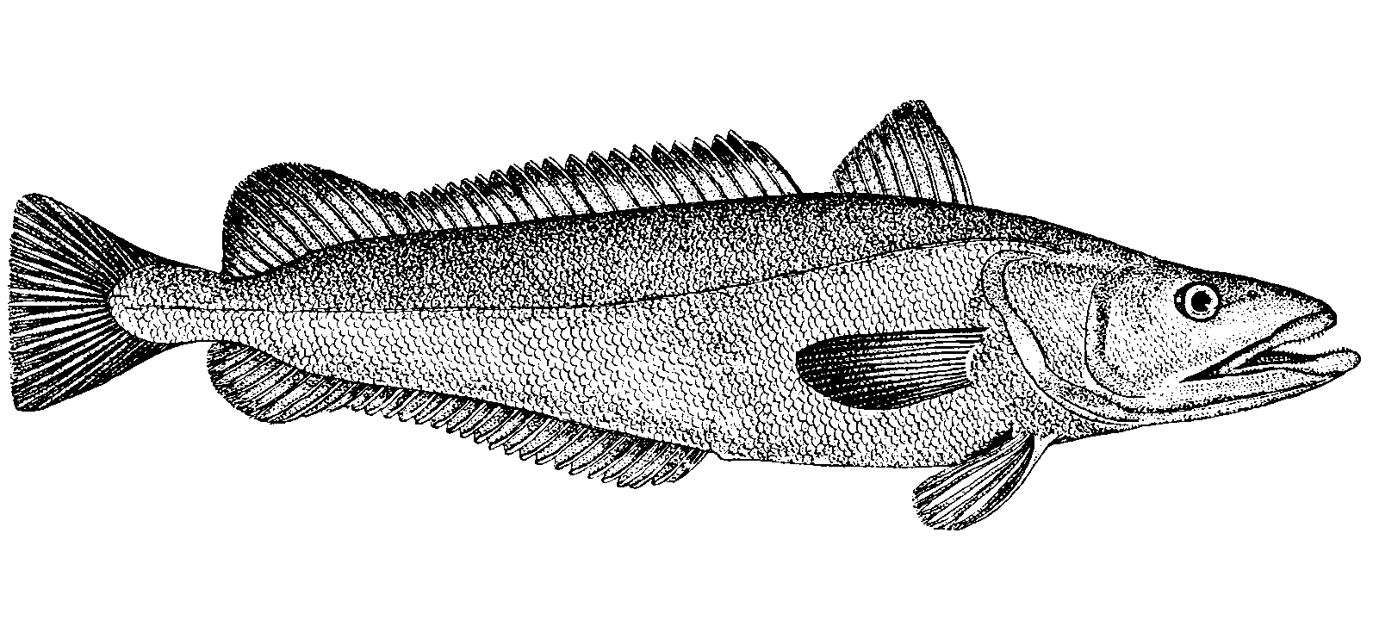
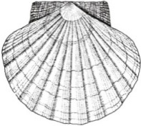
Science supporting fisheries management
Haddock
Monitor population change
Identify maximum sustainable yield that a stock can support
Provide catch advice based on the perceived condition of the stock
Cod
Whiting
Herring
Nephrops
Hake
Scallops

Slide 3
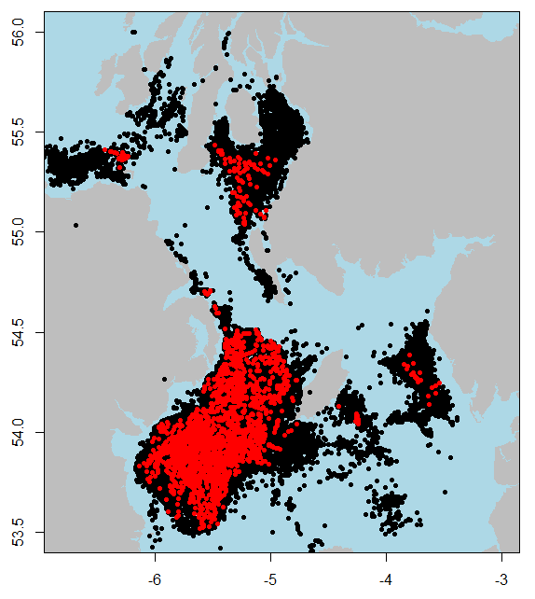
Data driven science
Fisheries dependent data:
-Sampling of commercial catch and landings
Port sampling
Observer sampling
Fisheries ‘self’ sampling
Industry partnership data collection
Fisheries independent:
- Research vessel surveys
Indices of abundance
Research vessel
Industry partnership Surveys
Species spatial distributions
Biological parameters
2016 – 11.5 million measurements

Slide 4
Two years in fisheries advice
Fisher self-sampling
Data
At sea observers
Port Sampling
Juvenile fish survey
Larval fish survey
Juvenile fish survey
Adult fish survey
Advice
Expert groups
Advice drafting
Quota negotiations

Slide 5

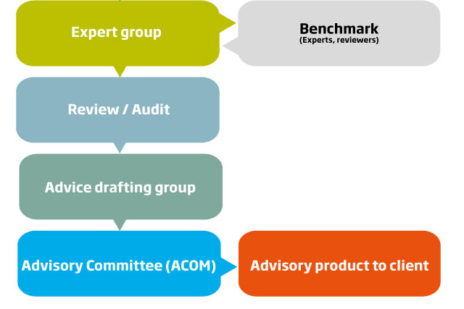


The catch advice process – scientific advice
AFBI’s role within the International Council for Exploration of the Seas (ICES):
Assessment input
Data collection
Expertise:
Model construction
Annual advice updates
Advice review
AFBI
AFBI /
DEARA

Slide 6
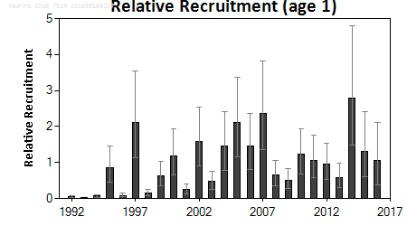
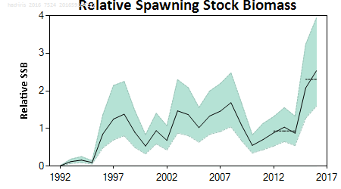
Benchmarking - Irish Sea haddock
 | Fishing pressure |  |  |  |  |  | Stock size
 |  | 2013 | 2014 | 2015 |  |  |  | 2014 | 2015 | 2016
Maximum sustainable yield | F_{MSY} | ? | ? | ? |  |  | MSY B_{trigger} | ? | ? | ?
Precautionary approach | F_{pa}, F_{lim} | ? | ? | ? |  |  | B_{pa}, B_{lim} | ? | ? | ?
Management plan | F_{MGT} | - | - | - |  |  | SSB_{MGT} | - | - | -

Slide 7
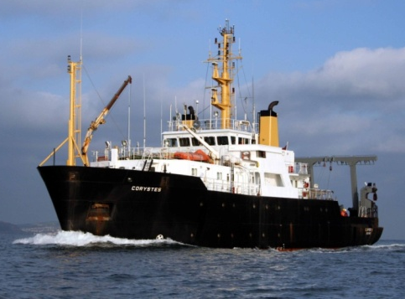
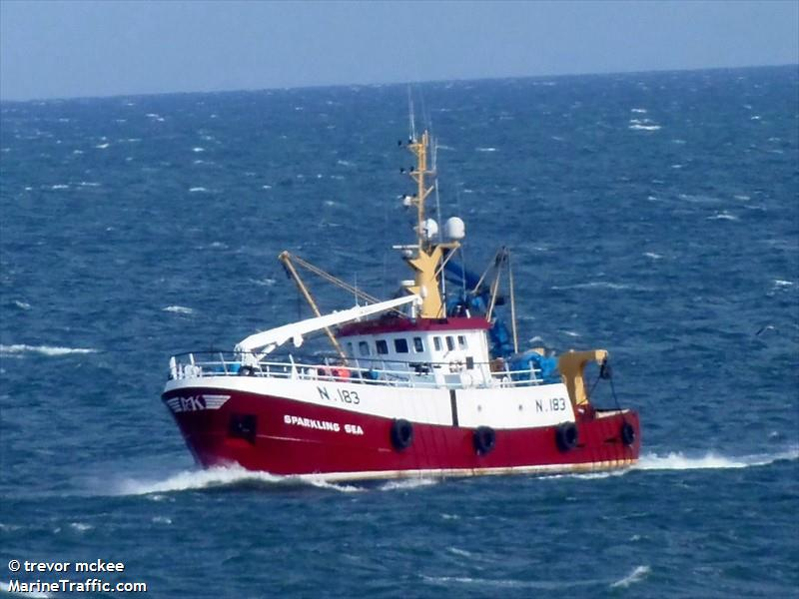
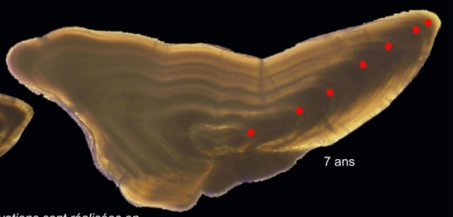
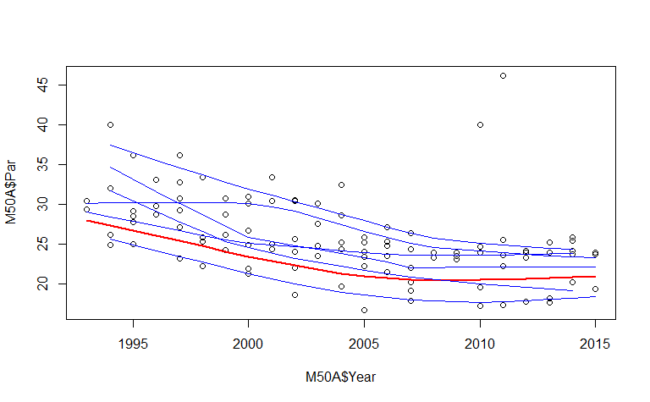
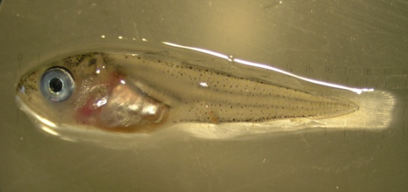
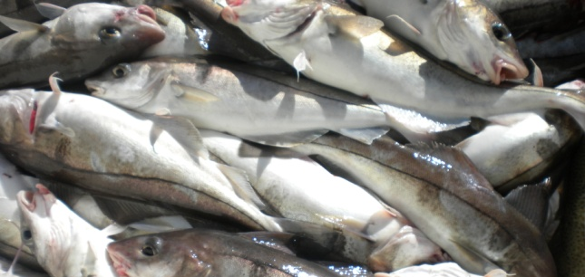
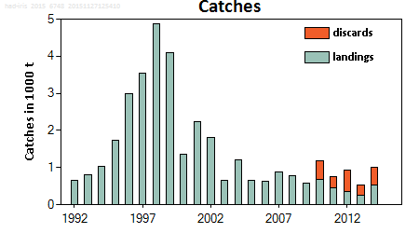
Irish Sea haddock – case study
AFBI led WKIrish ‘Benchmark’ January 2017
Survey series
Fishery data
Biological data
Age structure
Maturity
Length
Year

Slide 8
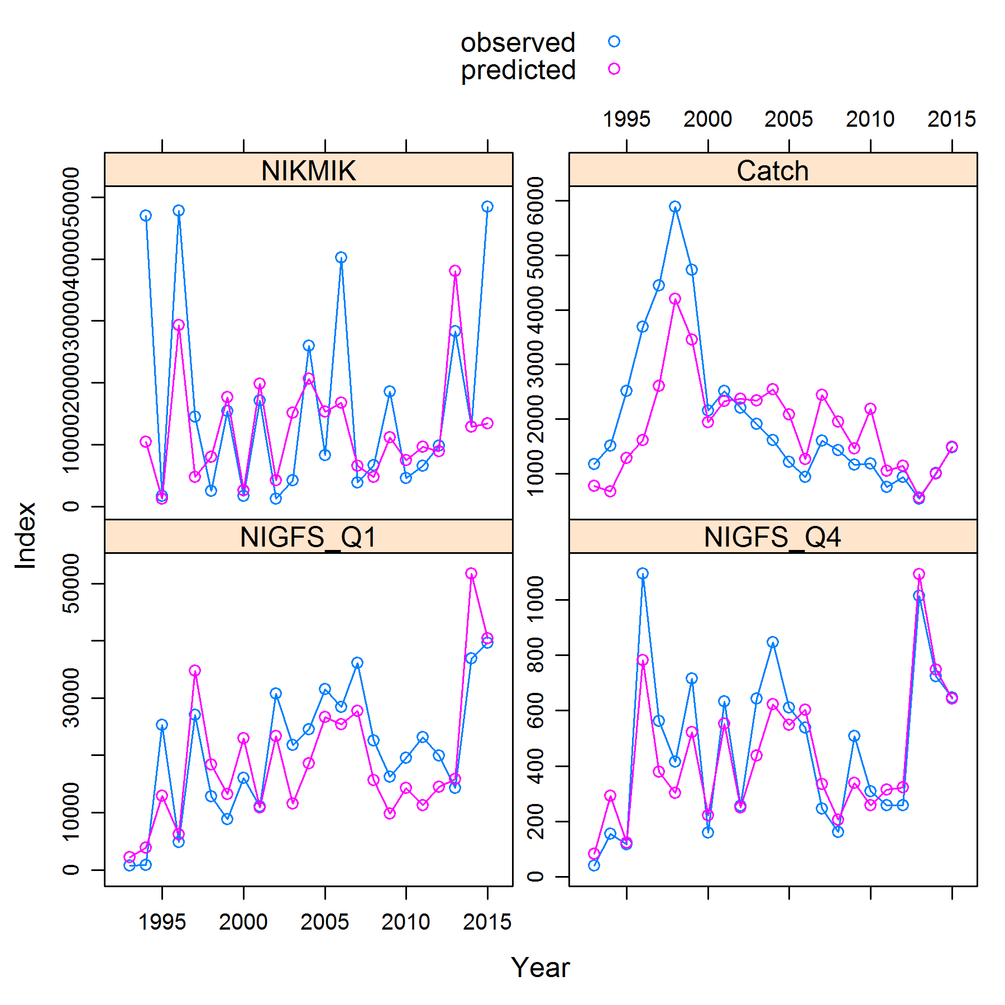
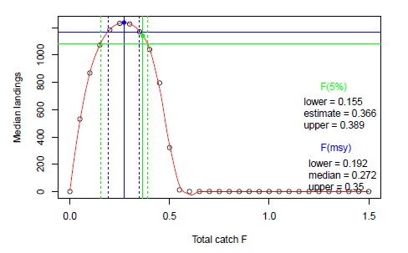
Irish Sea haddock – case study
AFBI led WKIrish ‘Benchmark’ January 2017
Population model Maximum Sustainable Yield

Slide 9
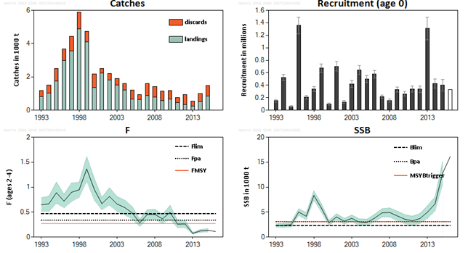
Present Irish Sea haddock – updated advice 2017
Catch advice revised from 1286t to 3061t

Slide 10
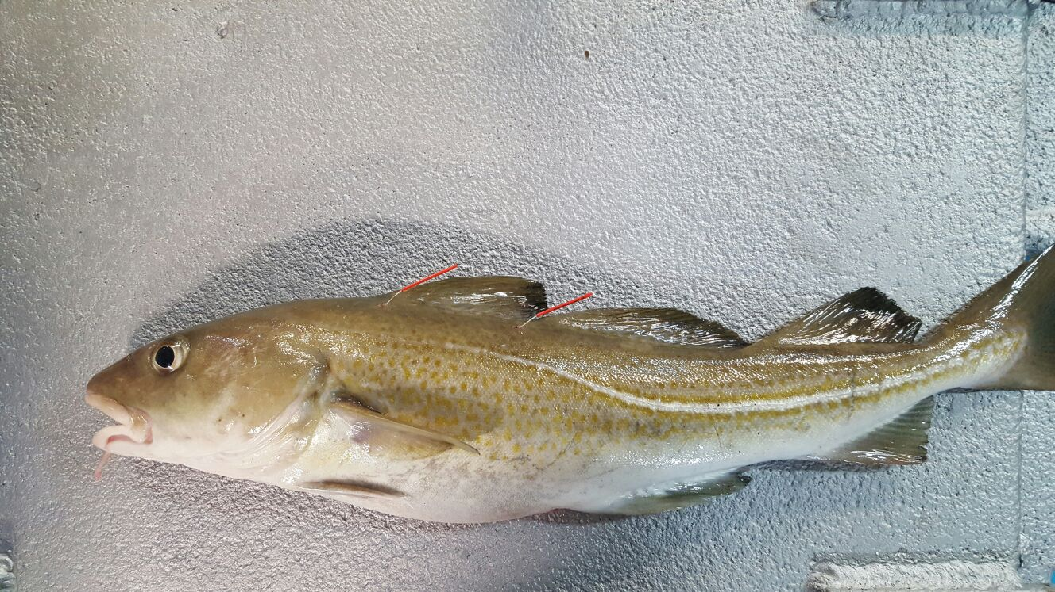
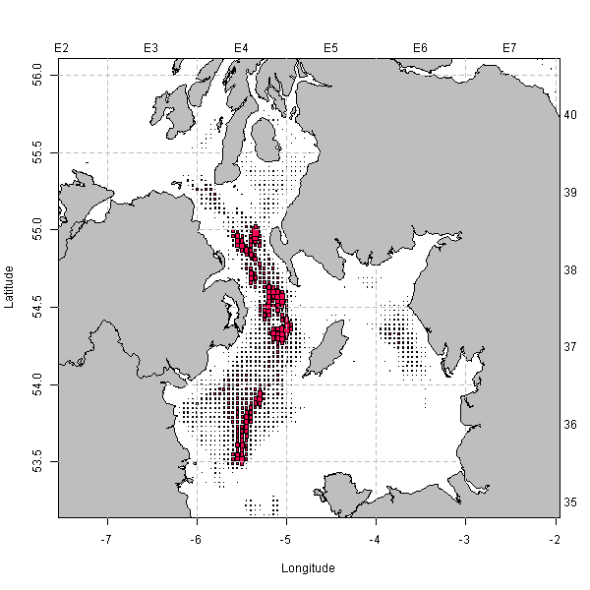
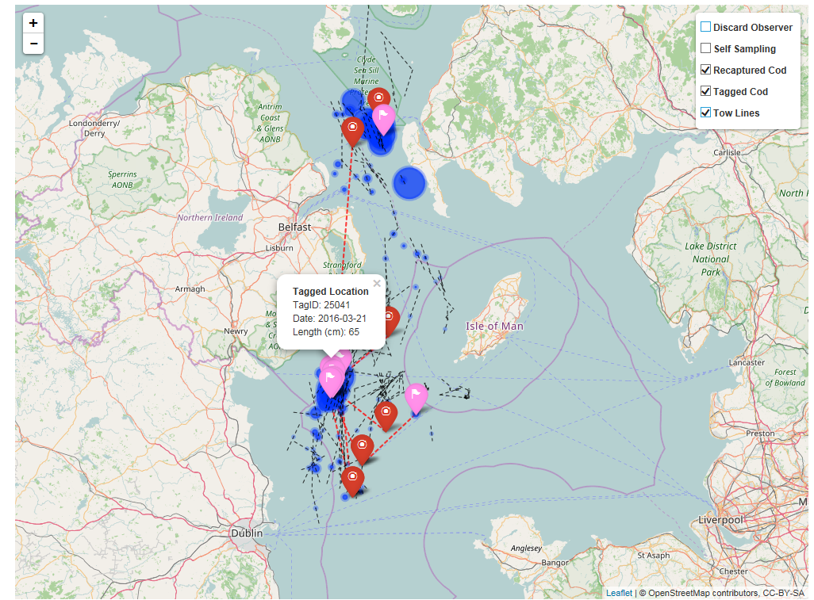
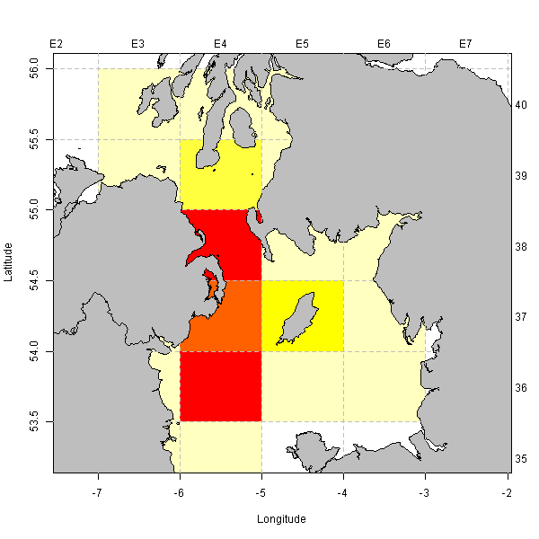
Looking ahead – utilisation of the data resource
Increased automation of data capture
Real time interactive reporting
Integration of data streams
High frequency data utilisation

Slide 11
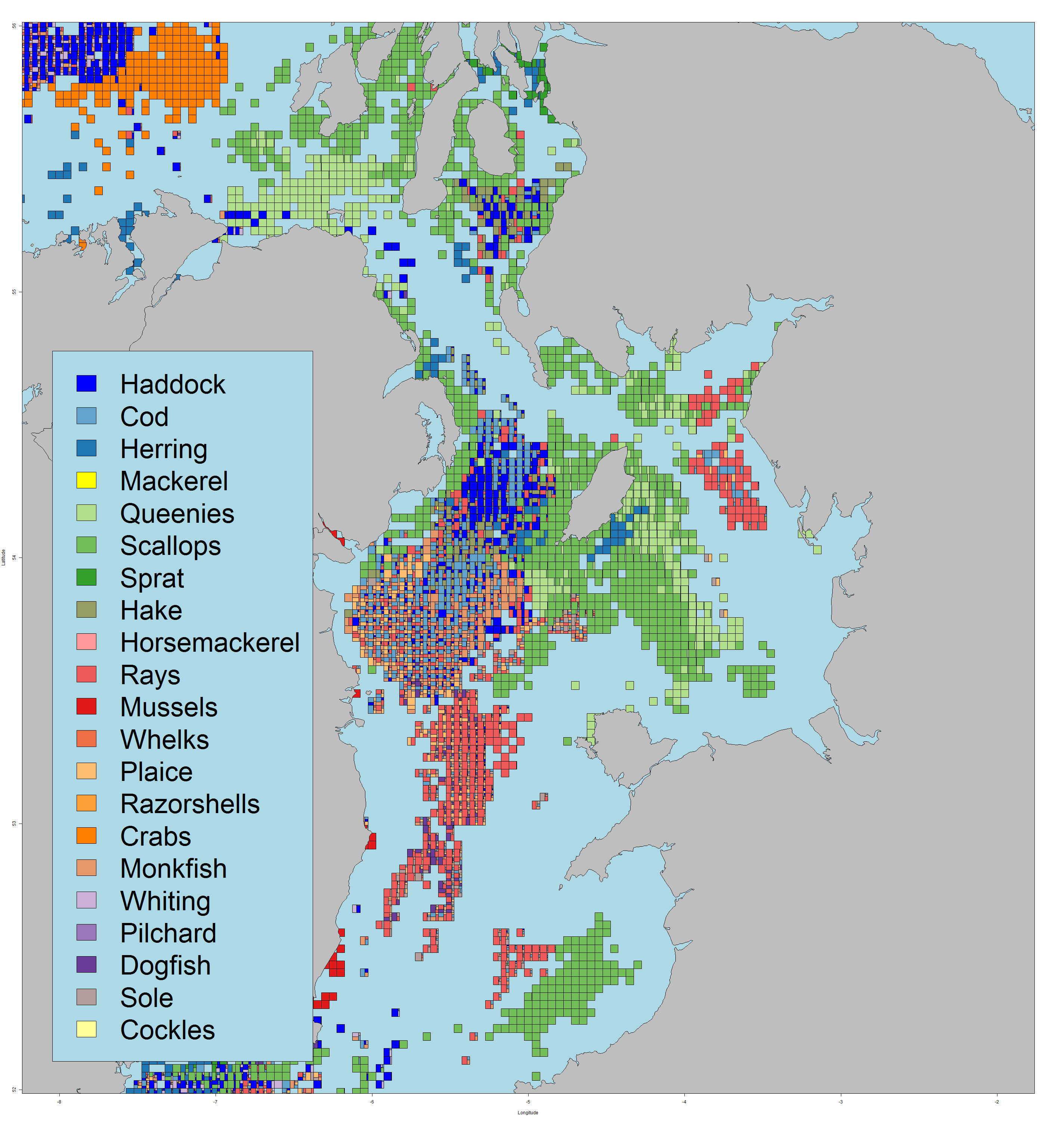
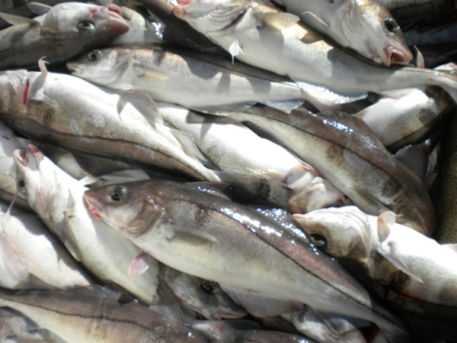
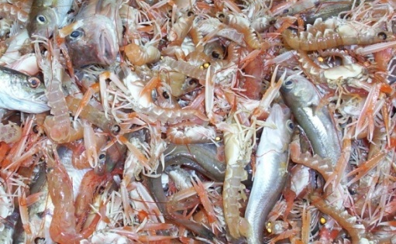
Looking ahead ... an ecosystem approach
Understanding the complexities of ecosystem interactions

