Slide 1
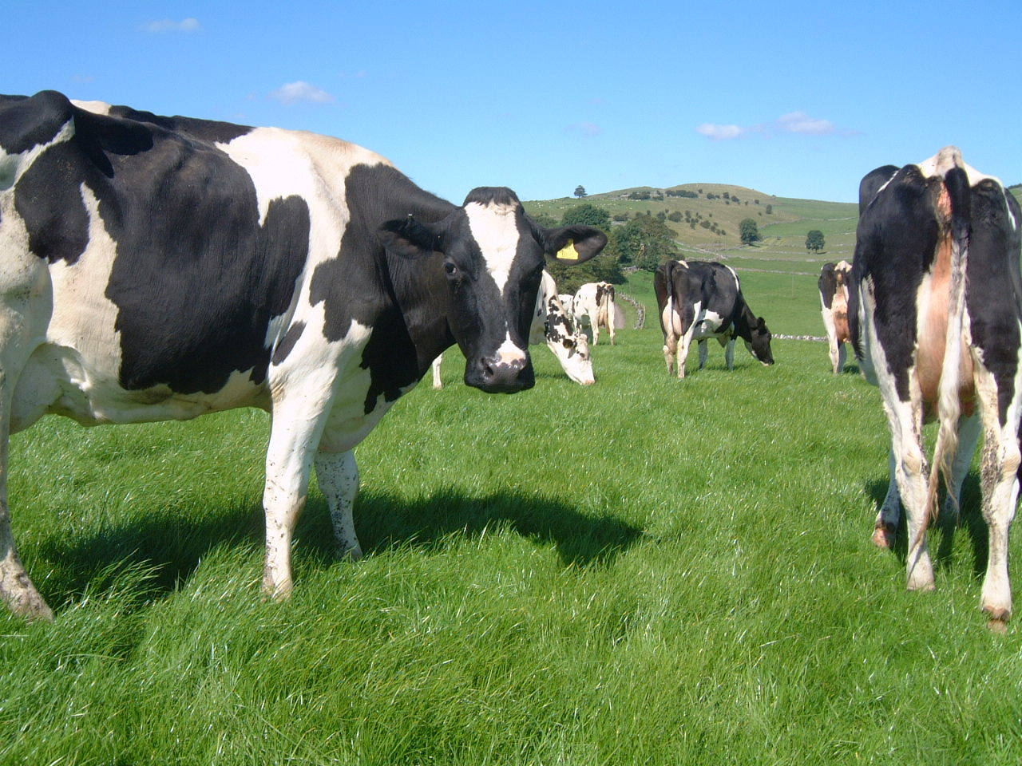
The Importance of Research and Innovation in the Dairy Sector
Dr Keith Agnew
Agri Food and Biosciences Institute
Stakeholder Day
1st June 2017

Slide 2
Overview
Opportunities & challenges
Forage production
Improving concentrate efficiency
  United Feeds projects
Precision farming

Slide 3
Opportunities for the Dairy Industry
Increasing global demand for dairy products
  population growth and diet change.
Positive outlook for prices in the medium term
  but increasing volatility.
Consumers increasingly interested in:
  health
  welfare
  sustainability attributes
Brexit
  £600m of dairy products imported from EU.

Slide 4
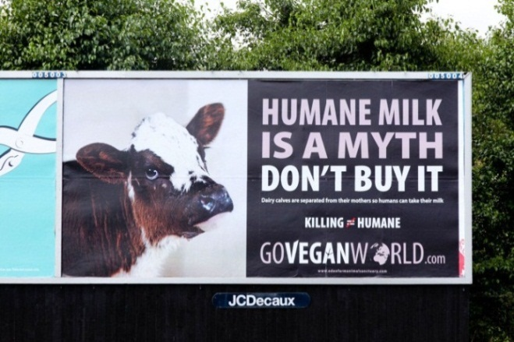


Challenges for the Dairy Industry
Brexit
  Lower levels of support and
  wide range in on-farm technical efficiency
Reputation:
Sustainability - fossil fuel, water, P, N, ammonia and GHG’s
Alternative sources of nutrients

Slide 5
CAFRE Benchmarking 15/16
 | Bottom 25% | Average all | Top 25% | Top 10%
MILK
Annual Production/Cow (l) | 7785 | 7669 | 7669 | 7291
Milk From Forage/Cow (l) | 1583 | 2180 | 2669 | 3083
Average Bactoscan ('000/ml) | 45 | 33 | 28 | 28
CONCENTRATE FEED
Meal Fed Per Cow (Kg) | 2791 | 2470 | 2250 | 1894
Meal Fed Per Litre (Kg) | 0.35 | 0.31 | 0.28 | 0.25
Margin over Concentrate (£/cow) | 893 | 988 | 1096 | 1140
Margin over Concentrate (ppl) | 11.62 | 13.00 | 14.45 | 15.71
FINANCIAL
Gross Margin | 448 | 656 | 847 | 910
Net Margin* | -79 | 215 | 456 | 521
*Net Margin does not include any Labour, Conacre or Finance costs

Slide 6
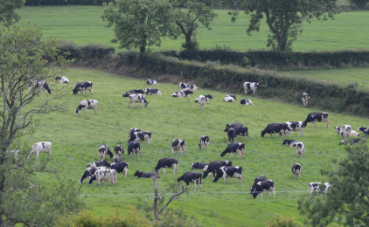
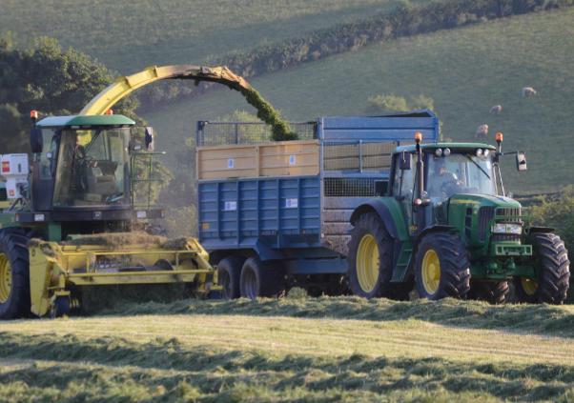
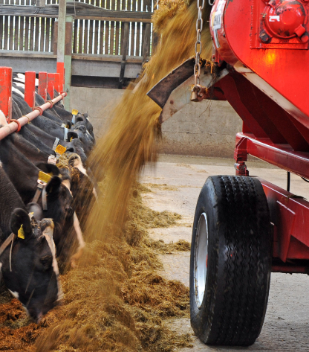
Controlling feed costs
More use of quality forage
More efficient use of concentrates
Grazed grass
Grass silage
Milk from forage currently around 2500
litres/cow/year

Slide 7
Current Grass Performance
Grass DM utilisable yield
  NI average 7.5t/ha/yr
  Achievable 12t/ha/yr
  Top farms 16t/ha/yr
Soil pH – 64% land below optimal pH of 6.
Only 18% soils at optimal fertility
Only 2% tested on annual basis.
(J Gilliland, 2016)

Slide 8
Production From Forage – 14 years on!
 | 2000 | 2014 | Change
Herd Size | 83 | 124 | +41
Milk Yield (l/cow) | 6000 | 7375 | + 1375
Meal fed (kg/cow) | 1250 | 2601 | + 1351
Milk from forage (l/cow) | 3222 | 1594 | - 1628
CAFRE

Slide 9
Silage Quality: 1996 - 2015
Mayne, Ferris & McConnell, 2017

Slide 10
Limiting Factors to Grass Use
Growing grass
  Soil fertility, structure, reseeding, weather
Utilisation
  Infrastructure, silage management, contractors, weather
  Zero grazing?
Farmer
  Interest, confidence, decision making, education
Variability
  The reason the US moved away from Alfalfa to Corn silage

Slide 11

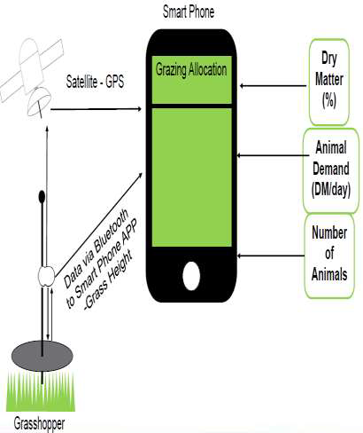
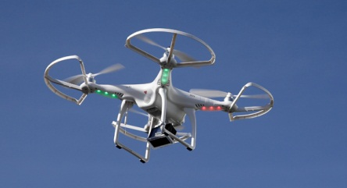
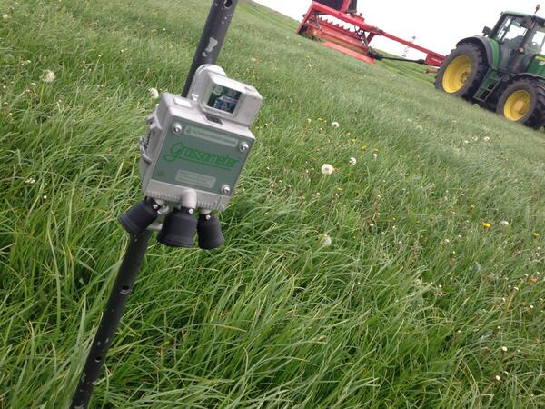
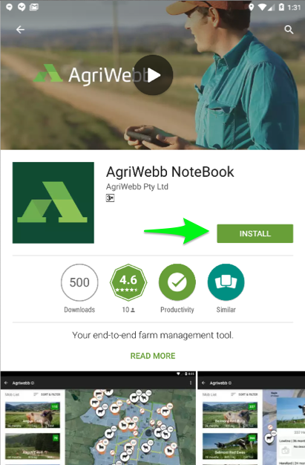
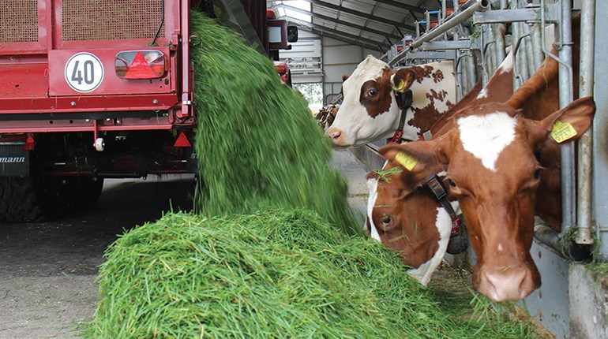
Technology to Improve Grass Utilisation

Slide 12

Profitability- for both ourselves and our customers.
Reduce biological variability and you reduce financial variability and risk.
Chemical measurement and biological worth are not the same thing – TMRs are hostile to analysis.
Quantifying biological synergies and antagonisms is a very real challenge.
Measurement of microbial biomass, CO₂ and CH₄

Slide 13
The Holy Grail
More bugs, more milk
 | Milk (lbs) | Gas Prod (mg/ml) | Microbial biomass (mg)
Farm 1 | 88.7 | 3.61 | 117
Farm 2 | 72.3 | 3.08 | 65
Farm 3 | 74.2 | 2.65 | 59.5
Farm 4 | 63.6 | 2.86 | 56.1

Slide 14
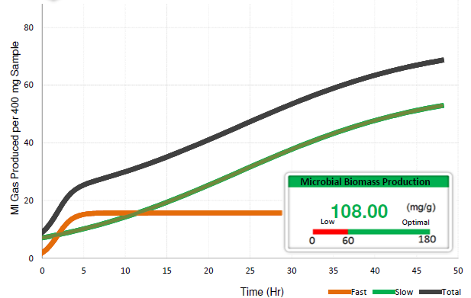
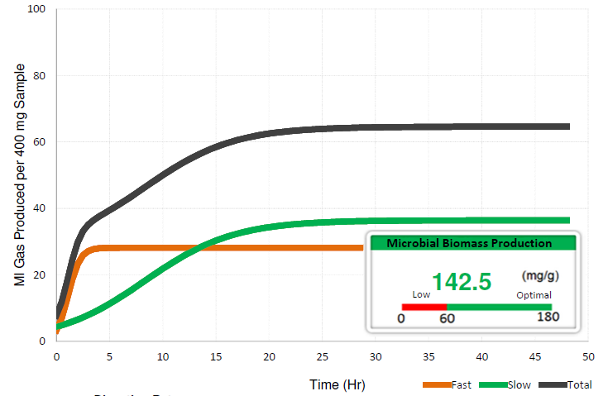
“When Things Happen is Very Important”
Grass silage samples from N Ireland
Both 70 D value
Very different levels of performance

Slide 15
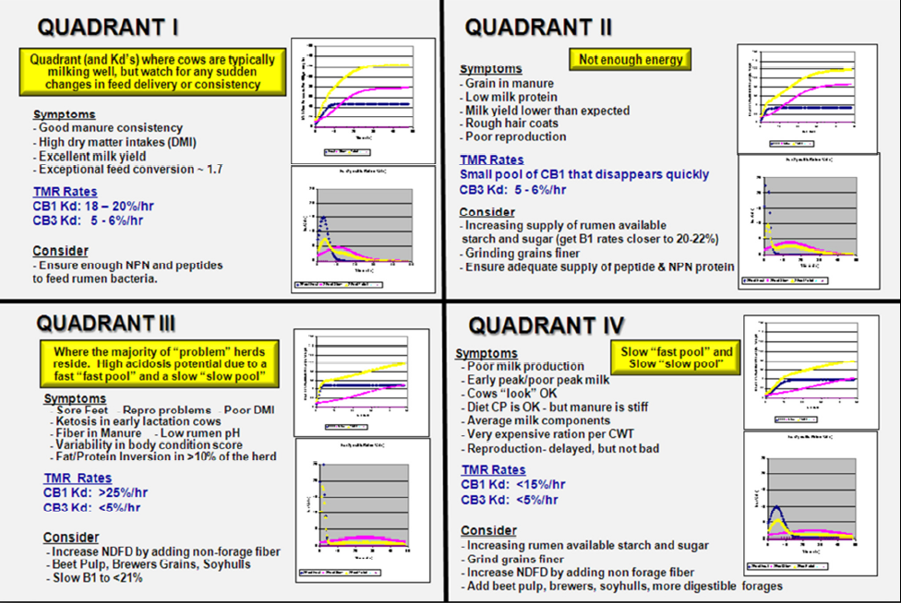

Slide 16
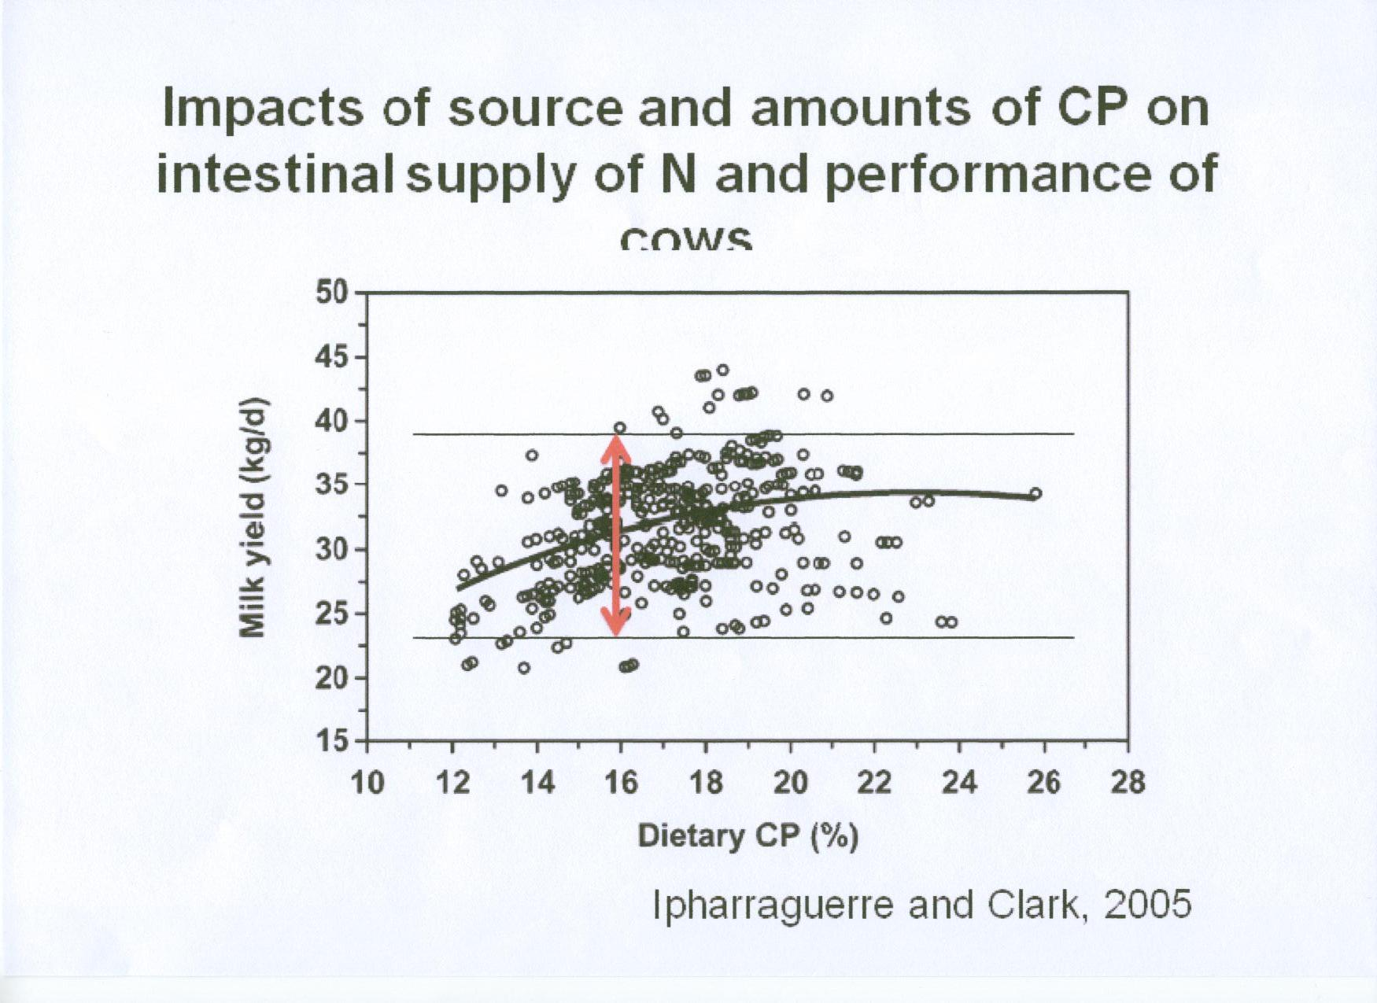
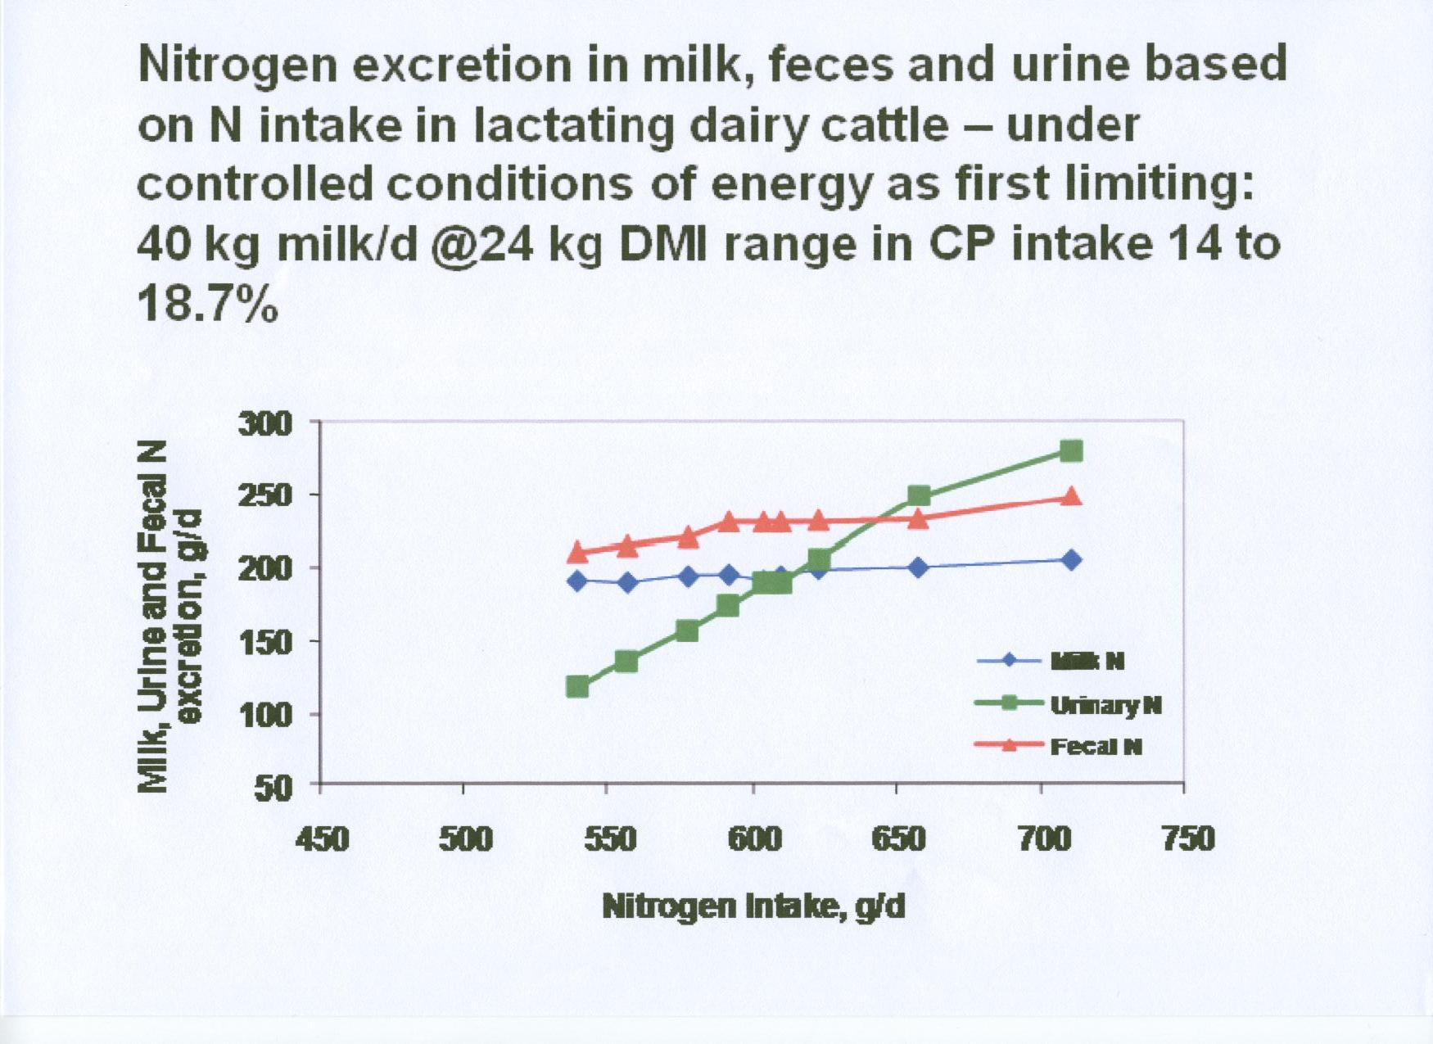
Low Protein Diets

Slide 17

Environmental impact
24kg DM @ 18.7% CP = N_{int} 718 g = Urine N_{out} 275 g
24kg DM @ 15.0% CP = N_{int} 576 g = Urine N_{out} 150 g/d
Difference of 125 g/d
125 g N for 150 days of lactation = 18.75 kg N
For 100 cows = 1,875 kg N
Equivalent of 7 tonnes of CAN (27% N) fertilizer

Slide 18
Low Protein Diets
 | 17.9% CP | 15.5% CP | Difference
Milk Yield (l) | 9370 | 9963 | + 593
Butter Fat (%) | 4.30 | 4.28 | - 0.02
Protein (%) | 3.19 | 3.39 | + 0.20
Calving interval (d) | 414 | 387 | - 27
Increased forage intakes
Flatter lactation curves
Improved N utilisation
Less body condition change
Cows more content
Silage quality important

Slide 19
Increasing the Value of milk
Aim to increase milk protein content
40 herds across N Ireland
Trail from November to April
Only change was the concentrate fed

Slide 20
Increasing the Value of milk
20% herds showed little or no response
  Genetics?
  Dietary antagonisms?
  Should we expect all cows to respond?

Slide 21
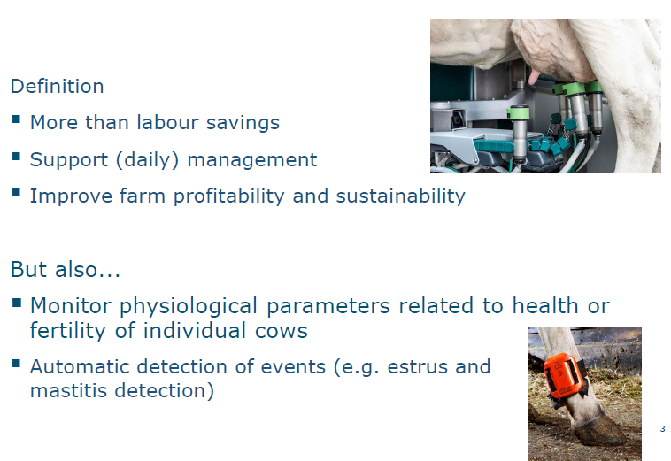
Precision Farming
Hogeveen & van der Voort, 2017

Slide 22
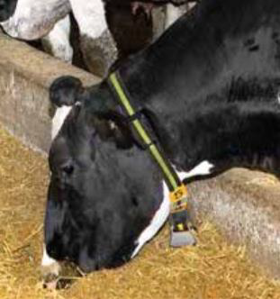
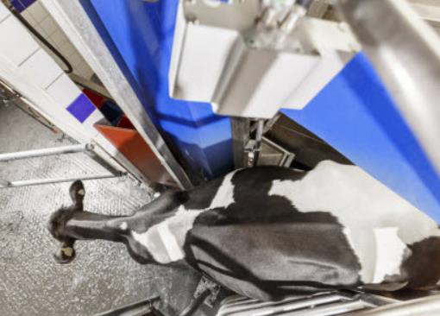
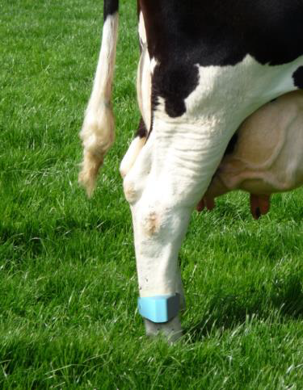
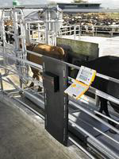
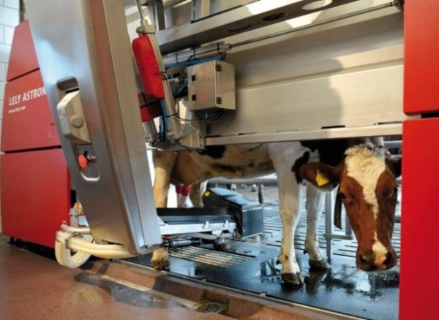
Data Collection
Key to be able to link all the data together for easy analysis and interpretation

Slide 23
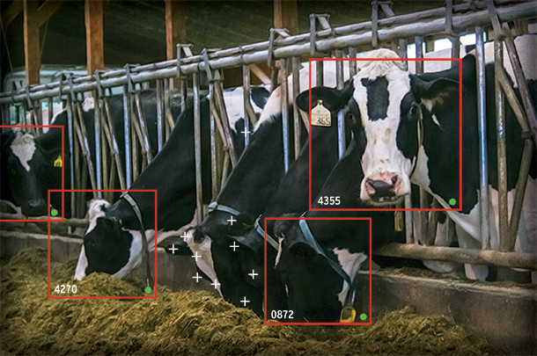

Computer Vision Technology
Facial recognition via cameras
30 images/second
Identifying deviations from the normal

Slide 24
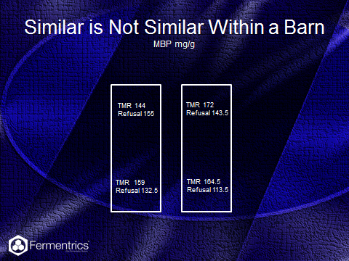

Slide 25
Computer Vision Technology
First systems in California, Dubai and China
Provides alerts for:
  Feed intake
  Lameness
  Oestrus detection
  Additional alerts only require an update
Potential to link to robots to give real time feed efficiency for individual cows
Cost benefits compared to RFID systems

Slide 26
Take Home Messages
Need to improve efficiency within dairy systems
Focus needed on forage production
  Soil management
  Grass production and utilisation
Technology required for easy data capture and interpretation
Decision making tools

Slide 27

Thank you

