Slide 1

Molecular Mechanisms of Environmental Perception
Dr Deborah Cox
Pest & Pathogen Molecular Biology (PPMB)
Agri-food & Bioscience Institute
Grassland & Plant Sciences
18a Newforge Lane, Belfast, BT9 5PX
Deborah.Cox@afbini.gov.uk
028909255271

Slide 2
Overview
Who I am and what I do
An introduction to Arabidopsis thaliana
Plant environmental perception
Short term & long term memory in plants
  Epigenetics & the FLC model

Slide 3
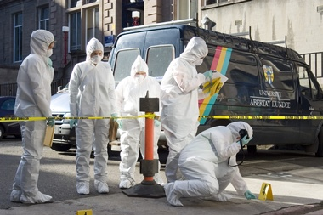
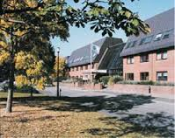
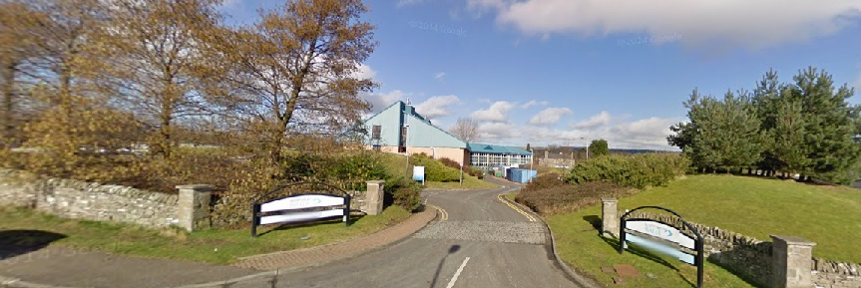
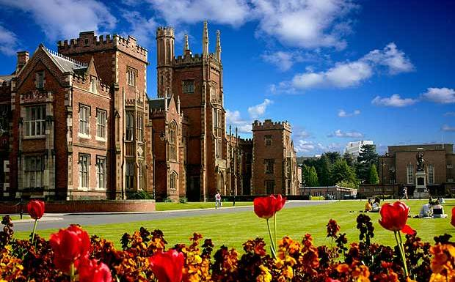
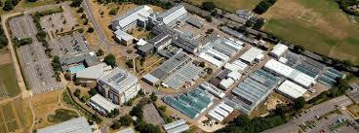
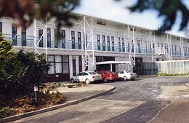
Who am I? My scientific career thus far…
Abertay University, Dundee
Scottish Water, Invergowrie, by Dundee
LGC Forensics, Teddington, Middlesex
Queen’s University, Belfast
John Innes Centre, Norwich
Queen’s University, Belfast
Agri-food & Bioscience Institute

Slide 4
Arabidopsis thaliana – the ‘garden weed’ proposed as a model organism
Friedrich Laibach & Erna Reinholz
    Short life cycle, small number of small chromosomes, small plant size, ease of genetic crossing, fecundity, ability to self-pollinate, and mutagenic potential!
  Albert Kranz & Magnus Nordborg
    Natural variation, evolutionary biology, quantitative trait loci mapping, ‘1001 genomes’, ‘1001 epigenomes’!
Caroline Dean & Martin Howard
  Flowering time, epigenetic regulation, mathematical modelling of environmental perception!
Notes:
Alexander Braun & Friedrich Laibach were two of the first scientists to document useful attributes of A. thaliana which could be useful in plant research. While Alexander was first to document an unusual double flower mutant of the species in 1873 it was Friedrich Laibach and his student Erna Reinholz who were the key advocates in the first 40 years of the 20th century for inclusion of a simple(r) model species for exploration of amiable traits such as shorter flowering time.
Albert Kranz was the pioneer of sourcing ‘ecotypes’ commonly known as the ‘Global Collection’ which is still used today. This founding collection has been used to generate numerous maps for genes involved in a mairaid of phenotypes such as germination, inflorescence structure, metabolite content, growth dynamics,

Slide 5
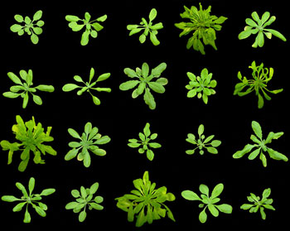
The potential of Natural Variation
Phenotype A
Phenotype B
Photo credit: https://www.wur.nl/en/article/Natural-variation-in-stomatal-responsiveness-of-Arabidopsis-thaliana-plants-grown-at-high-and-moderate-relative-humidity..htm
Common genotype – common phenotype…is that the end of the story?
Breeding for one trait at a time is technology of the past

Slide 6
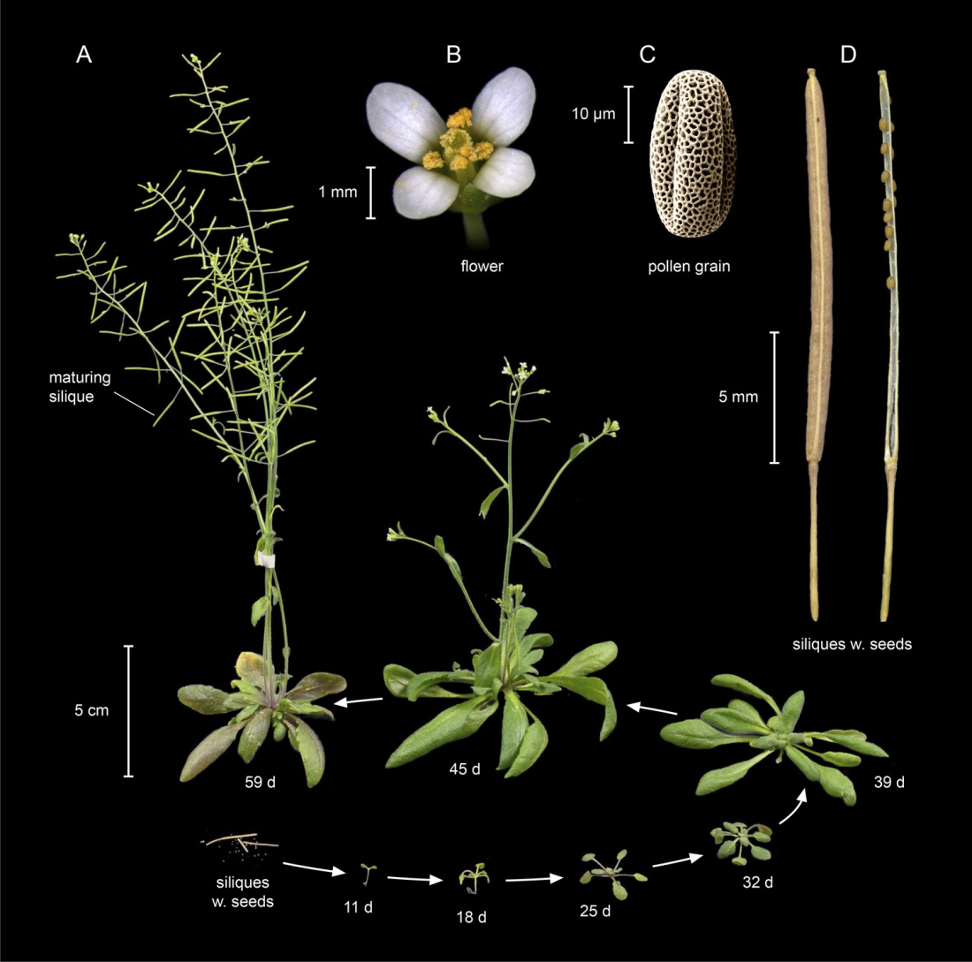
The A. thaliana Life Cycle
Krämer, U., 2015. Elife, 4, p.e06100.

Slide 7
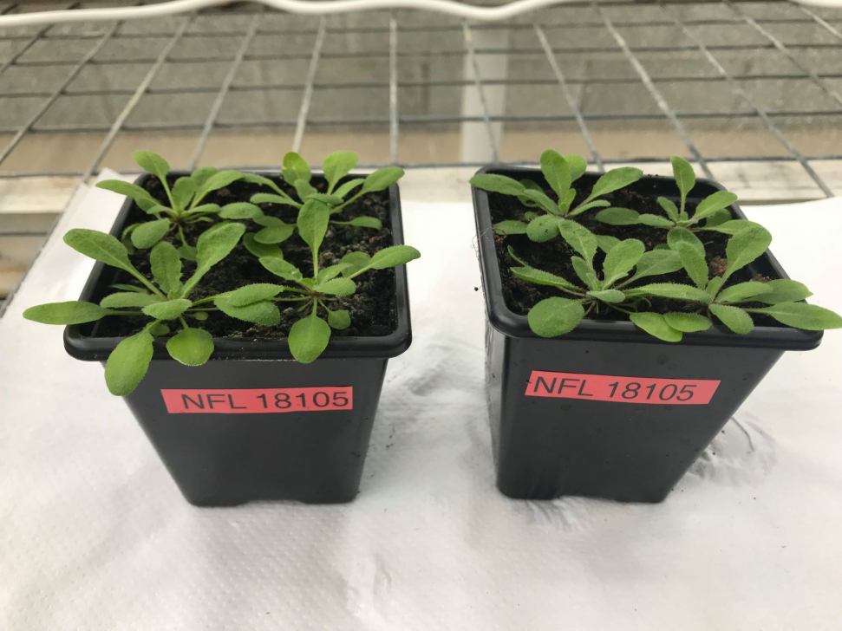
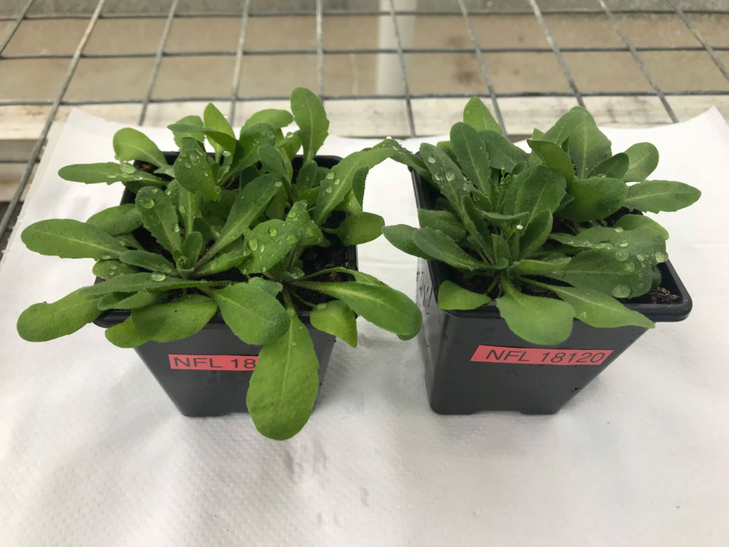
A. thaliana: Two life histories
Summer Annual
Winter Annual

Slide 8
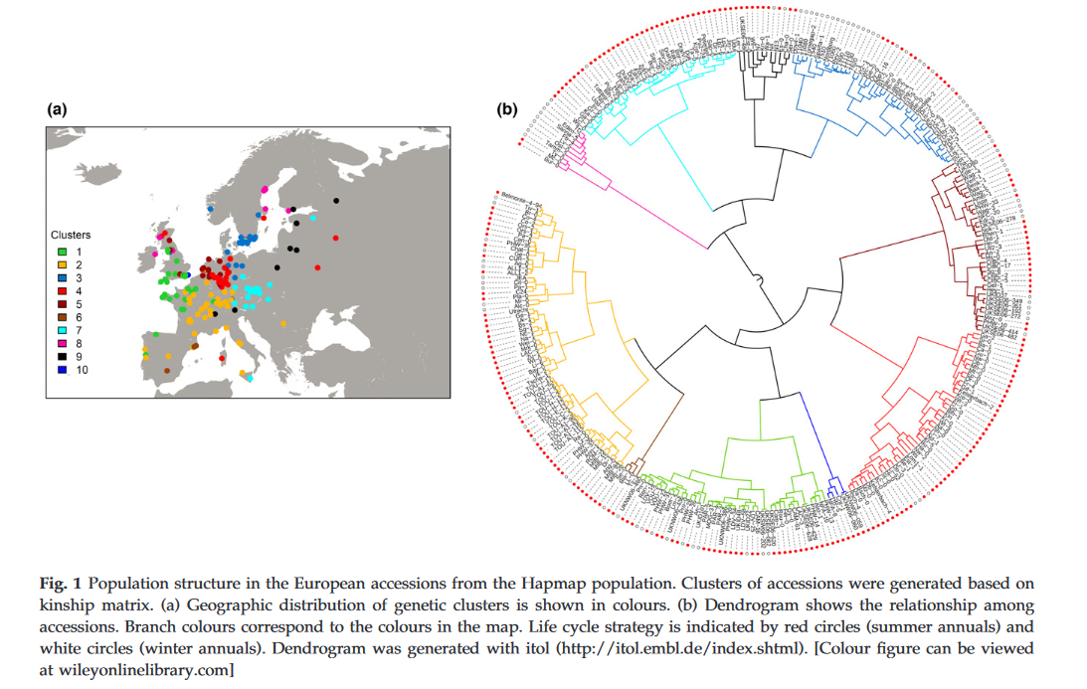
EU Distribution of
Early & Late Flowering A. thaliana
Davila Olivas, N.H., et al., 2017. Molecular ecology, 26(11), pp.2959-2977.

Slide 9
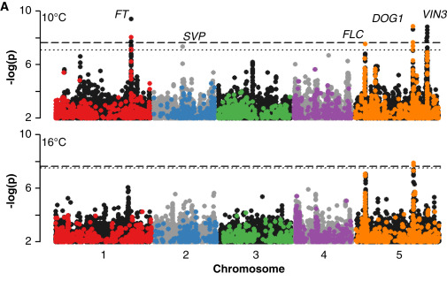
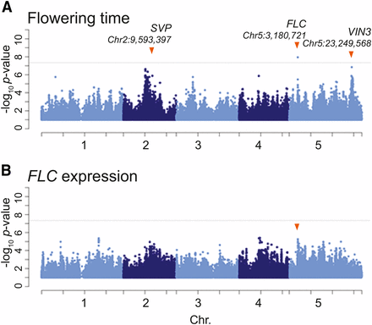
Flowering Time is a Polygenic Trait
Alonso-Blanco, C., et al., 2016. Cell, 166(2), pp.481-491.
Sasaki, E., et al., 2018. G3: Genes, Genomes, Genetics, 8(9), pp.3059-3068.
Notes:
Temperate cereals require prolonged periods of cold in order to gain competence to flower.

Slide 10
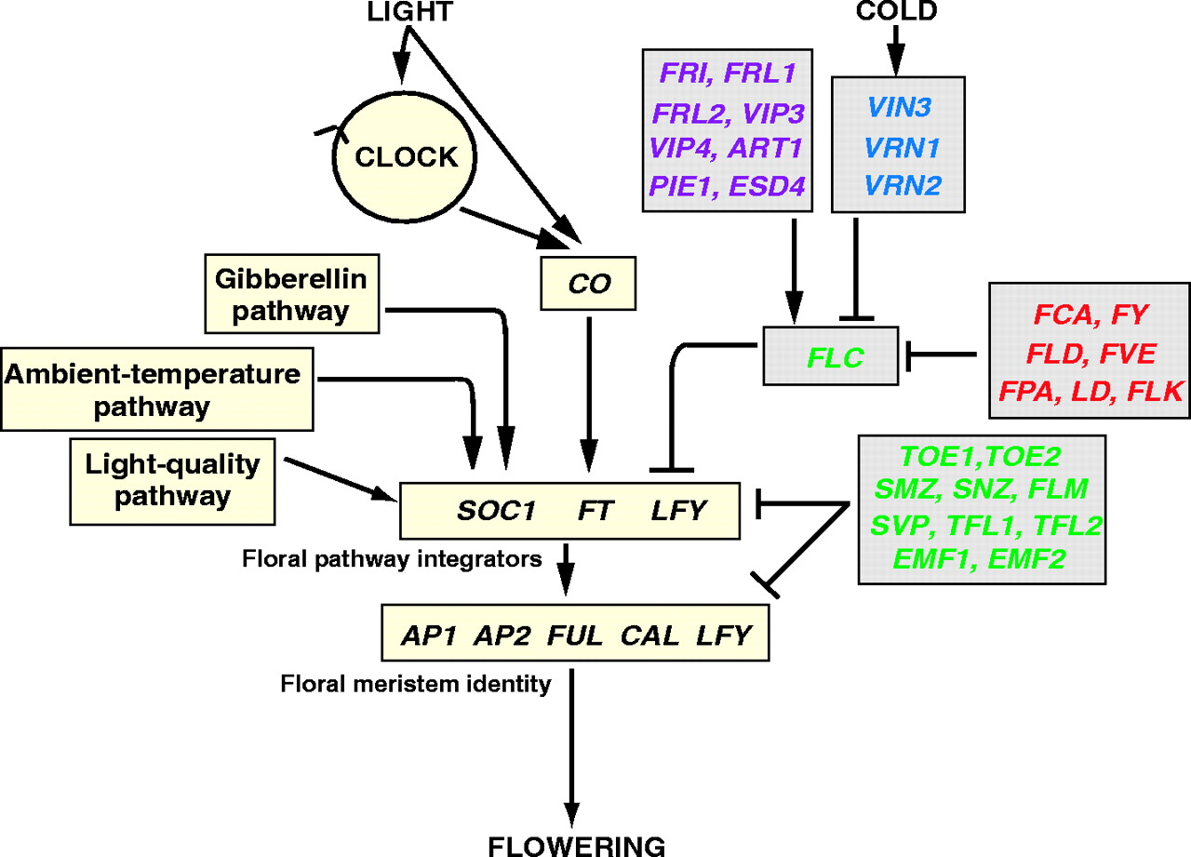
Genetic Control of Flowering time in A. thaliana
Henderson, I.R. and Dean, C., 2004. Development, 131(16), pp.3829-3838.
Notes:
“Endogenous pathways function independently of environmental signals and are related to the developmental state of the plant; such pathways are sometimes referred to as “autonomous” to indicate the lack of environmental influence”.

Slide 11
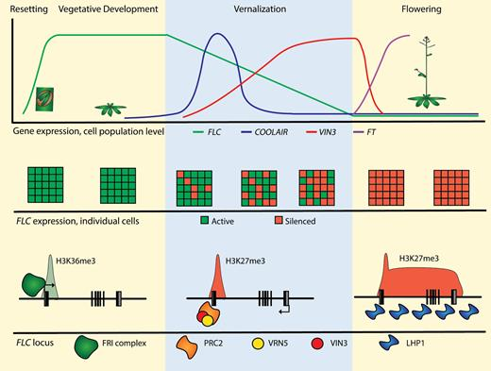
The FLC gene & Environmental Perception
Bloomer, R.H. and Dean, C., 2017. Journal of Experimental Botany, 68(20), pp.5439-5452.
Notes:
Add a video of the elevator scene from Elf!

Slide 12
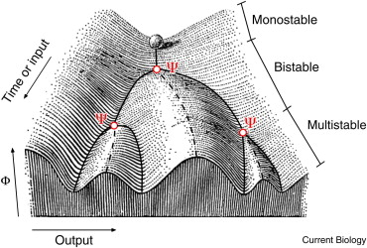
Waddington's Epigenetic Landscape
Waddington, C.H., 2014. The strategy of the genes. Routledge.

Slide 13
Reading the epigenetic landscape
deborahs inspiration comes from cooking her beloved family friends and pet cat
  Deborah’s inspiration comes from cooking her beloved family, friends, and pet cat.
  Deborah’s inspiration comes from cooking, her beloved family, friends, and pet cat.

Slide 14
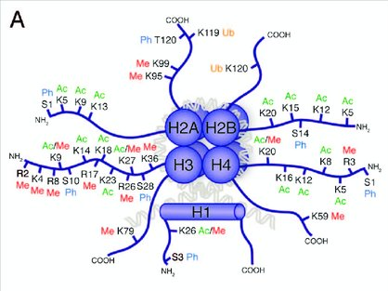
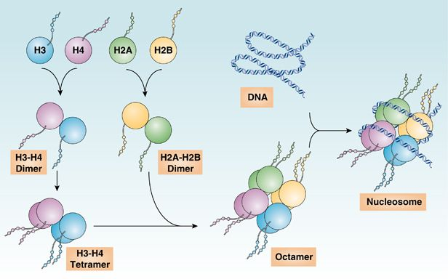
How do Plants ‘Remember’ Winter?
Chen, R., et al., 2014. Cell death & disease, 5(8), p.e1370.
Tollervey, J.R. and Lunyak, V.V., 2012. Epigenetics, 7(8), pp.823-840.

Slide 15
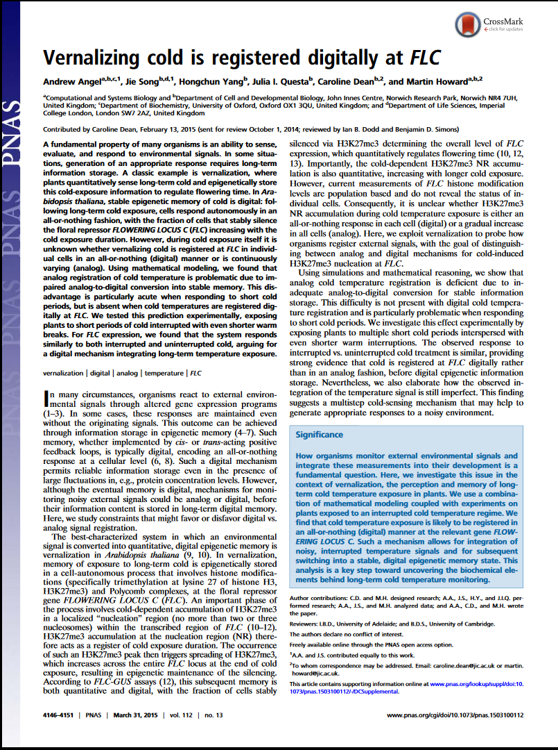
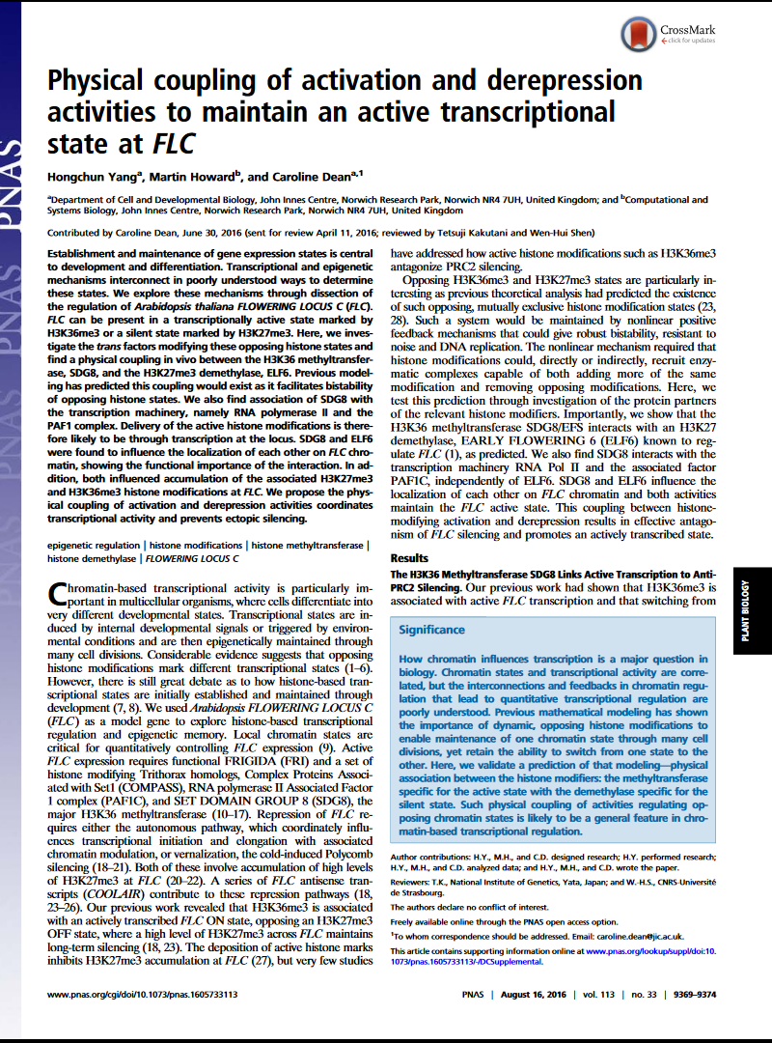
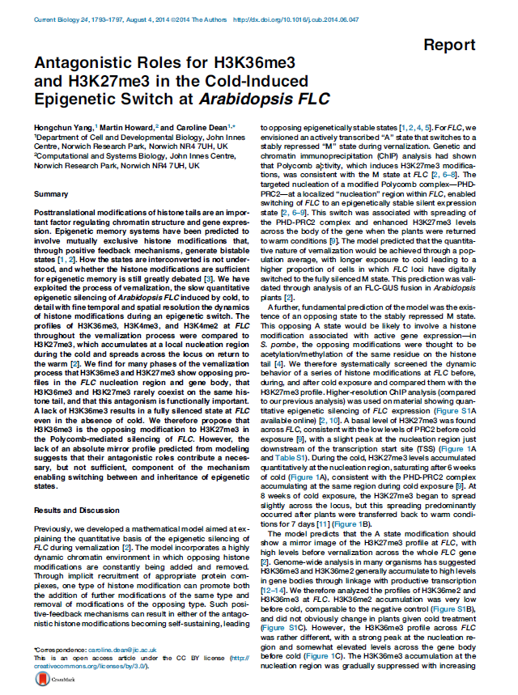
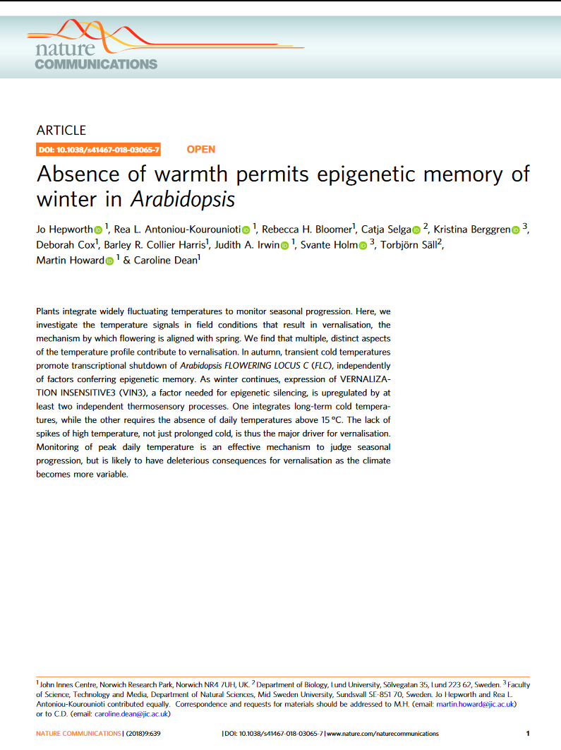
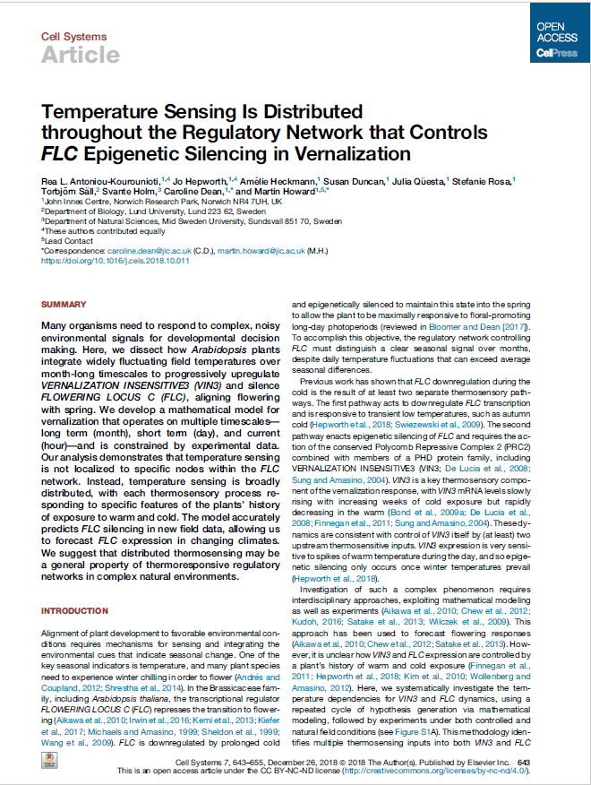
How does A. thaliana register epigenetic memory at the FLC locus?
+ More papers coming from this project in 2019

Slide 16
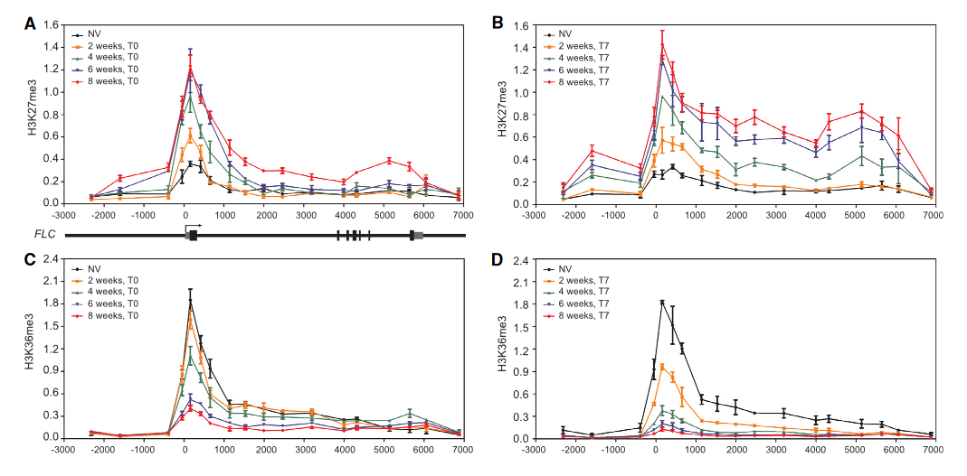
How does A. thaliana register epigenetic memory at the FLC locus?
Yang, H., Howard, M. and Dean, C., 2014. Current Biology, 24(15), pp.1793-1797.

Slide 17
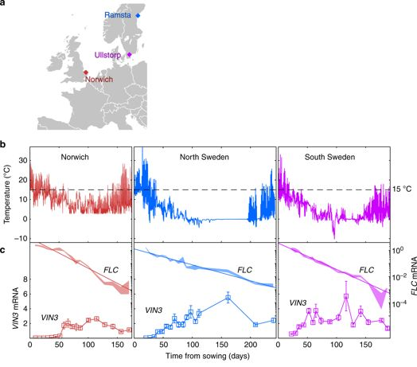

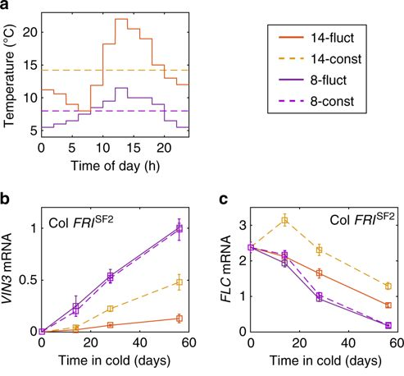
How does this compare to the field?
Hepworth et al, 2018. Nature Communications. 9. 639.

Slide 18
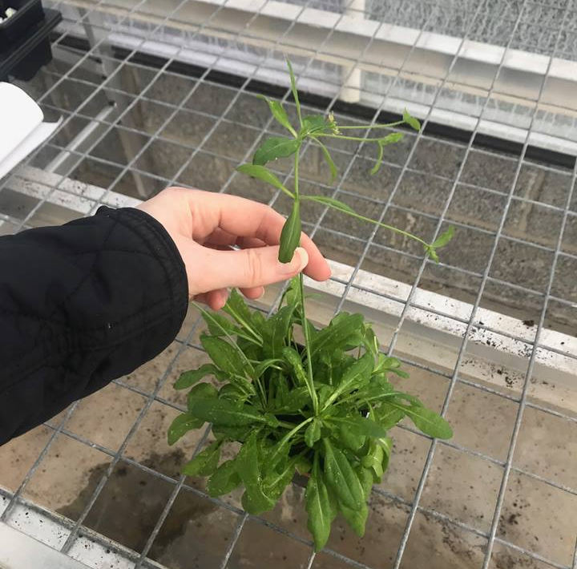
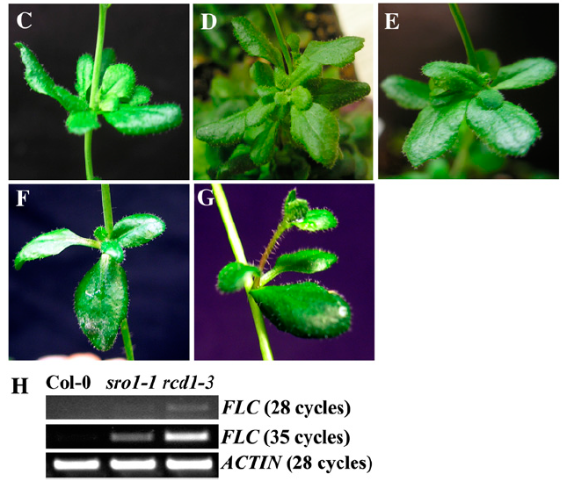
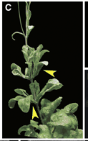
Naturally occurring ‘mutants’ that do not follow the rules!
Teotia, S. and Lamb, R.S., 2009. Plant Physiology, 151(1), pp.180-198; Keller, T., et al., 2006. The Plant Cell, 18(3), pp.598-611.

Slide 19
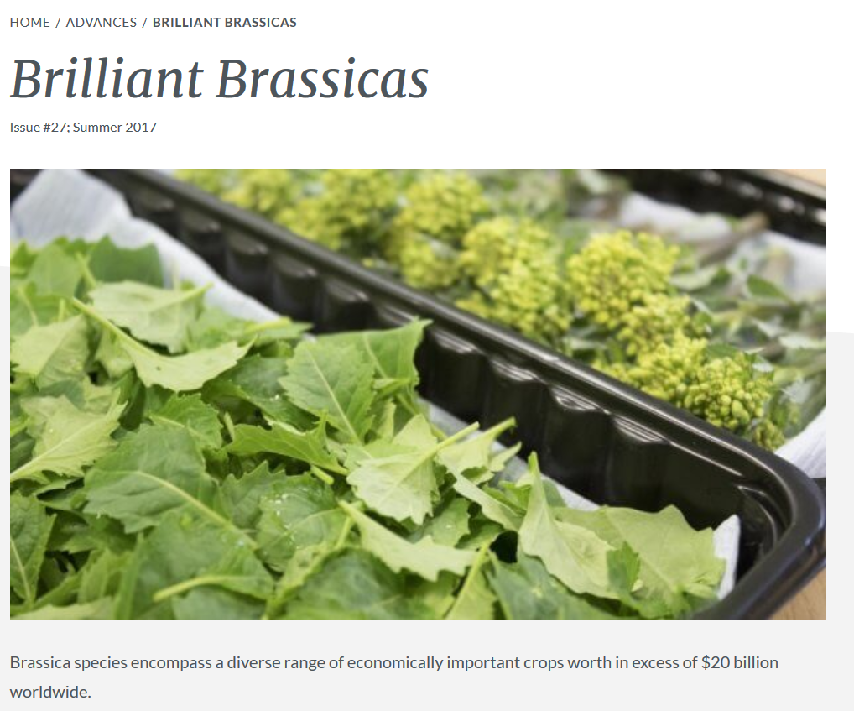
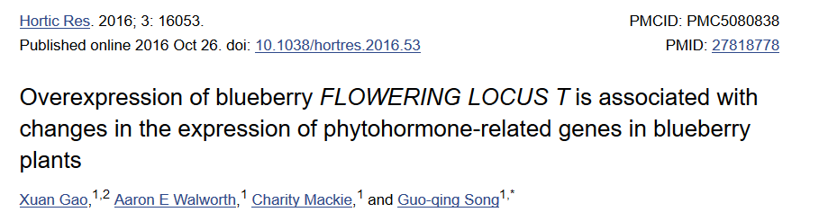
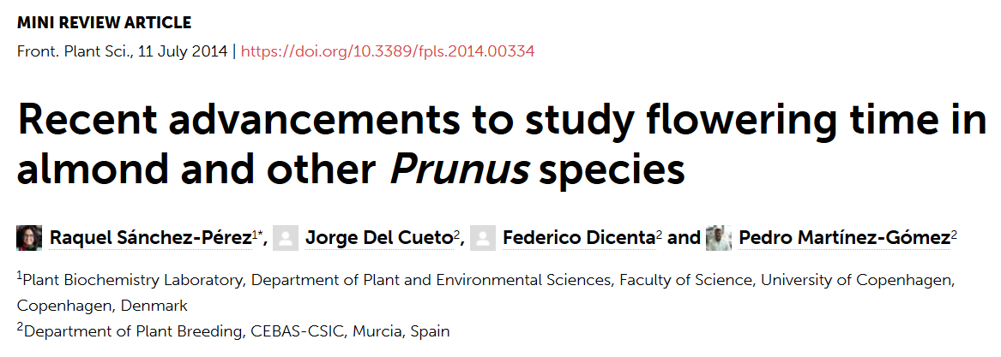
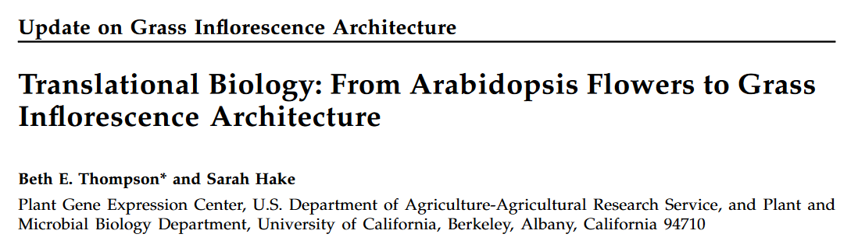
Translating A. thaliana research to crop Species!
Orthologous signalling pathways defined in other brassicas
Faster cropping/ higher turnover per year
Understanding genotype-environment interactions in the context of a gene network

Slide 20
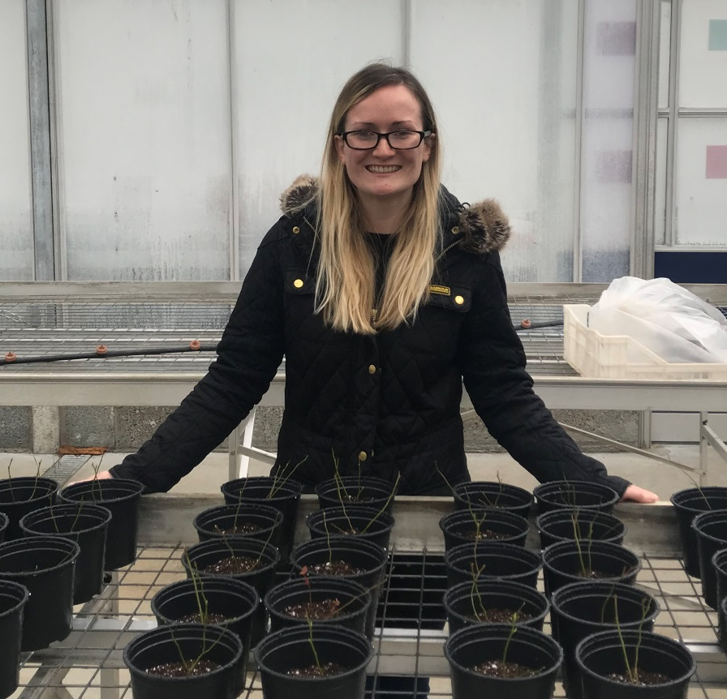
Any questions?
Dr Deborah Cox
Pest & Pathogen Molecular Biology (PPMB)
Agri-food & Bioscience Institute
Grassland & Plant Sciences
18a Newforge Lane, Belfast, BT9 5PX
Deborah.Cox@afbini.gov.uk
028909255271

