Slide 1
Using GrassCheck
to drive grassland productivity
Dr Debbie McConnell
Agriculture Branch

Slide 2
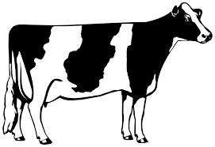
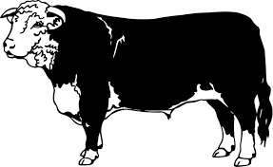
Driving grassland production and utilisation
Grassland agriculture will be pivotal to ensuring sustainable N.I. dairy, beef and sheep industries
Meet growing consumer demands for sustainable produce
Essential to increase on-farm technical efficiency post Brexit
Strong financial benefit to improving grass growth and utilisation
Estimated grass utilisation on NI farms (Mayne and Bailey, 2016)
+£441/ha
+£204/ha

Slide 3
GrassCheck: Grass growth and quality monitoring
Research aims:
Provide detailed understanding of grass growth potential across Northern Ireland
Identify actual variability in grass production and quality on commercial farms
Provide core evidence base for policy on grassland productivity of Northern Ireland farms
Knowledge exchange benefit:
Provides weekly grass growth an quality data to assist farmers in grassland management decisions

Slide 4
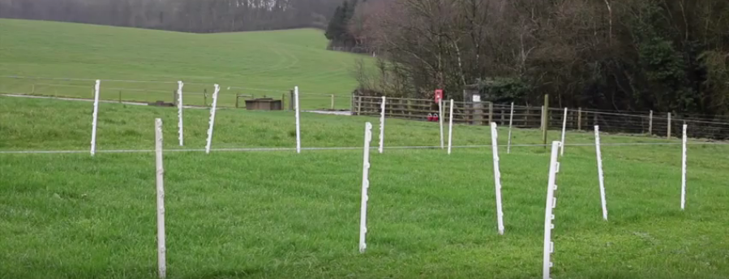
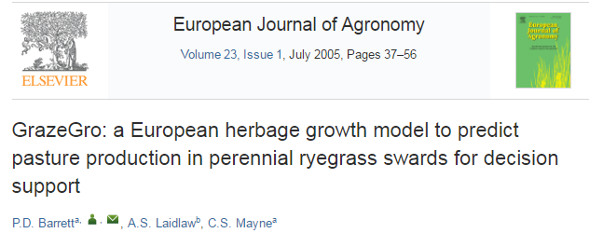
GrassCheck: Grass growth and quality monitoring
Weekly monitoring of two core locations:
CAFRE, Greenmount
AFBI, Hillsborough
Managed to replication intensive dairy grazing regime
Herbage mass and quality measurements
Forecasts based on GrassCheck model (Barrett & Laidlaw, 2004)
AFBI world-leading in developing grass growth predictions

Slide 5
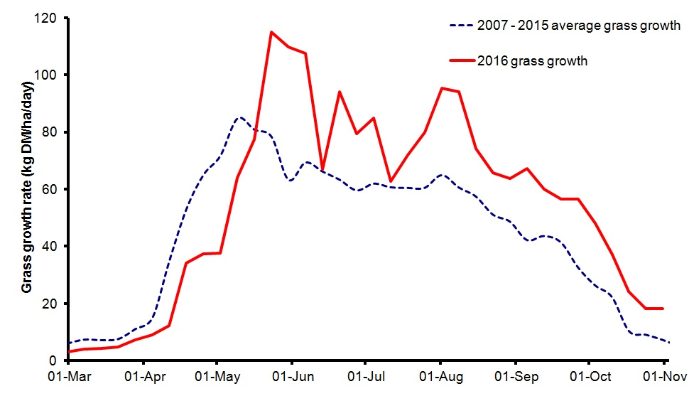
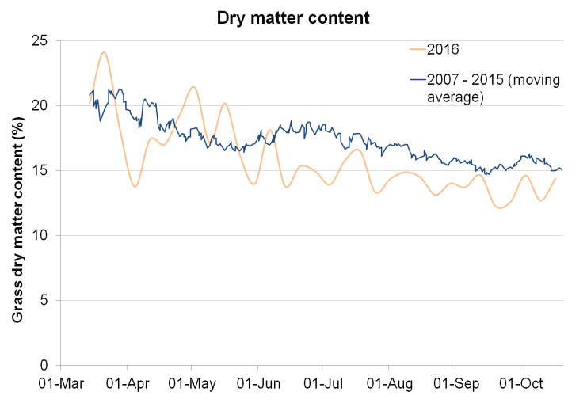
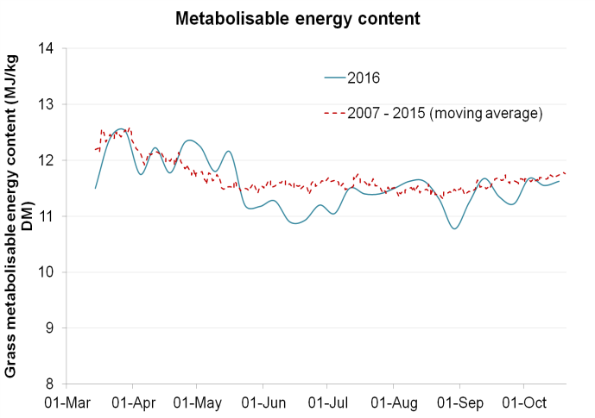
GrassCheck: Grass growth and quality monitoring
Dry matter content
Grass Growth | 2016 | 2007 - 2015
Spring (t DM/ha) | 1.0 | 0.7
Summer (t DM/ha) | 10.4 | 7.8
Autumn (t DM/ha) | 2.4 | 1.6
Total | 13.6 | 11.2
Metabolisable energy

Slide 6
GrassCheck: Grass growth and quality monitoring
Weather aid 2002 =
£5.4 million
Fodder crisis 2013 =
£1 million

Slide 7
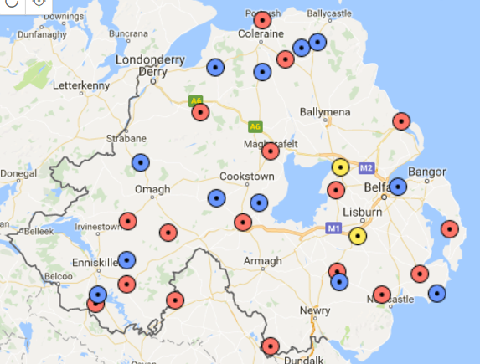
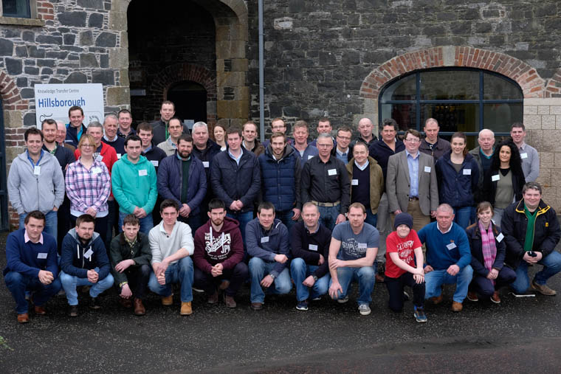
GrassCheck 2017: Grass monitoring network
Monitoring of grass growth and quality
Grass utilisation
Farm management data
35 dairy, beef and sheep farmers
Range of systems, land type, growth potential and management intensity

Slide 8
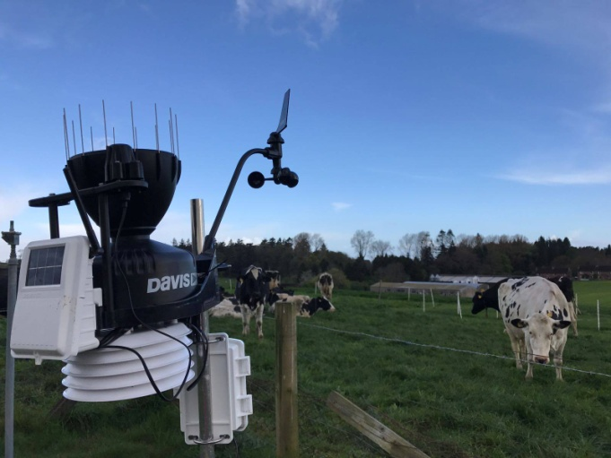
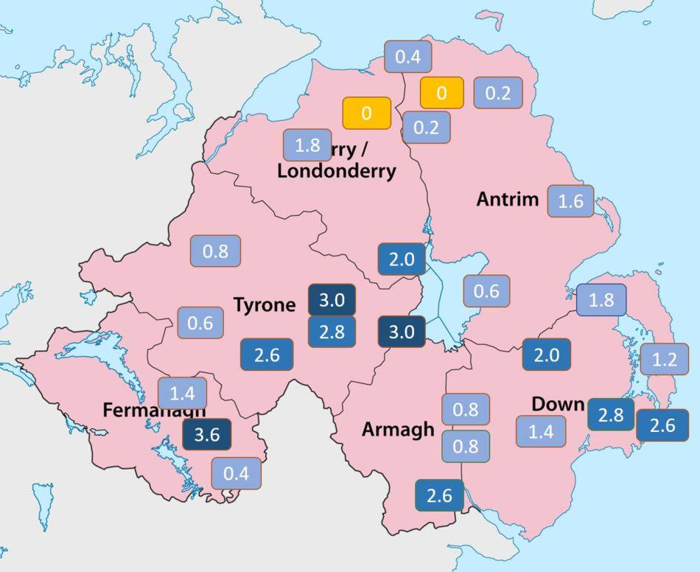
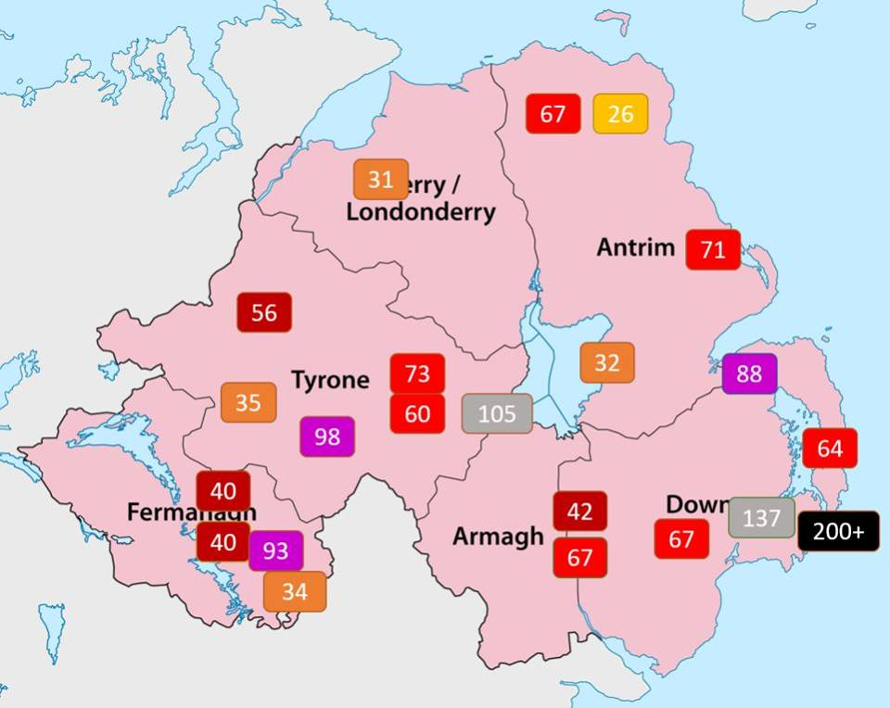
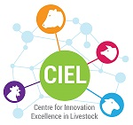
GrassCheck 2017: Grass monitoring network
Supported by a network of 30 weather stations
Access to real-time weather information across Province
Daily soil moisture readings
Daily rainfall monitoring

Slide 9
GrassCheck 2017: Grass monitoring network
GrassCheck May 2017
 | Total rainfall (mm) | Soil moisture (centibars) | Average daily temperature (ºC) | Daily growth rate (kg DM/ha) | Total yield (kg DM/ha)
Antrim | 49.4 | 17.6 | 12.0 | 101.9 | 3 159
Armagh | 42.4 | 27.7 | 12.4 | 63.4 | 1 965
Down | 35.3 | 55.2 | 11.9 | 60.3 | 1 870
Fermanagh | 46.8 | 17.1 | 12.3 | 87.8 | 2 721
Londonderry | 35.7 | 17.6 | 12.2 | 89.0 | 2 758
Tyrone | 53.2 | 15.7 | 12.3 | 92.2 | 2 858
Average | 43.8 | 25.2 | 12.2 | 82.4 | 2 555
Notes:
Yield gap between Antrim and Down = 1289kg DM/ha, worth an additional 2097 litres per hectare.

Slide 10
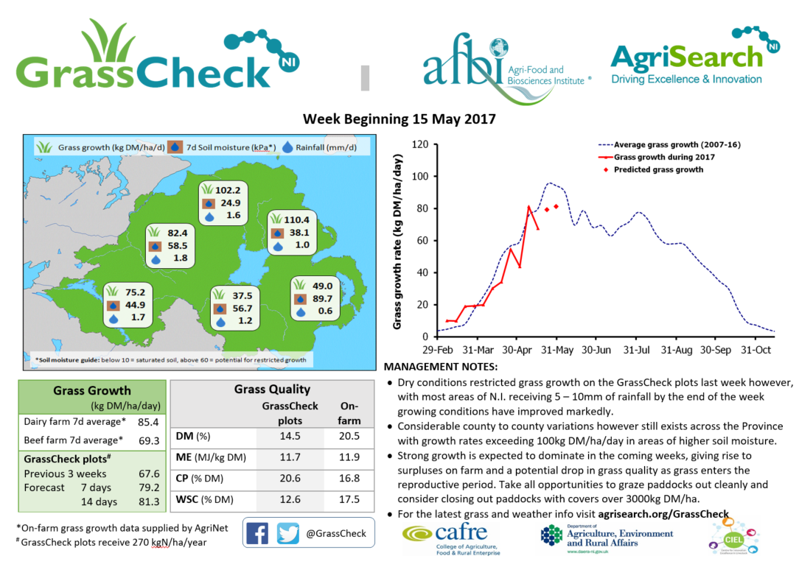
GrassCheck 2017: Sharing the science
Weekly publication of GrassCheck bulletin in major farming publications
2017: Movement to online platforms
Particular focus on social media
Past 28 days:
Reached 35 780 people
Engaged 9 861 people
4 866 video views
@GrassCheck:
229 followers
33 000 impressions
563 profile visits
Notes:
Yield gap between Antrim and Down = 1289kg DM/ha, worth an additional 2097 litres per hectare.

Slide 11
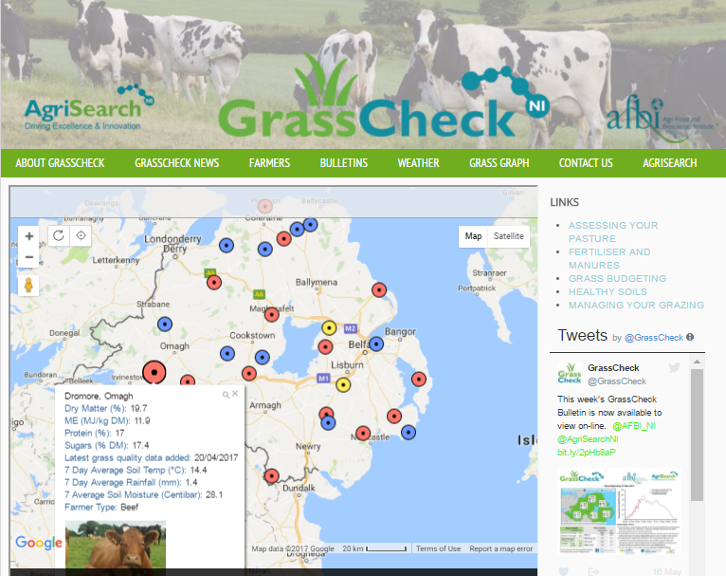
GrassCheck 2017: Sharing the science
www.agrisearch.org/grasscheck
Interactive map:
Weather
Grass quality
Grass growth rates
Links to:
grass management resources
Weather station live feed
Historic data
Notes:
Yield gap between Antrim and Down = 1289kg DM/ha, worth an additional 2097 litres per hectare.

Slide 12
Grasscheck online
www.agrisearch.org/grasscheck
Interactive map:
Weather
Grass quality
Grass growth rates
Links to grass management resources

Slide 13
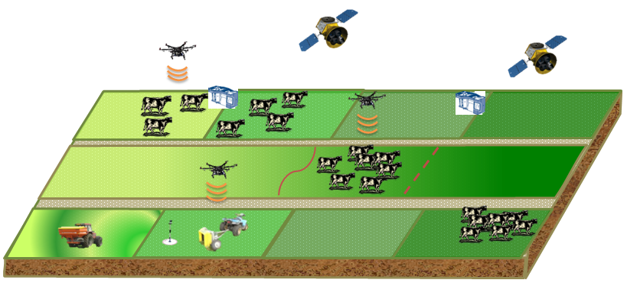
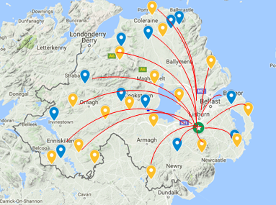
Grasscheck next steps
Precision Grassland Platform currently under construction at AFBI
Using research to drive innovation and technological advances in the industry
Continued work with our network of farmer co-researchers across N.I. to evaluate these technologies

Slide 14
Summary
Regular grass monitoring provides important research data to aid grassland management on dairy farms and informs policy development
High levels of engagement with farming industry in press and social media platforms
Continue to work with our network of farmer co-researchers to monitor grass utilisation and evaluate the potential of new technologies for grass assessment

