Slide 1
Data Infrastructures: European and Global
Mark Hebden
British Oceanographic Data Centre

Slide 2
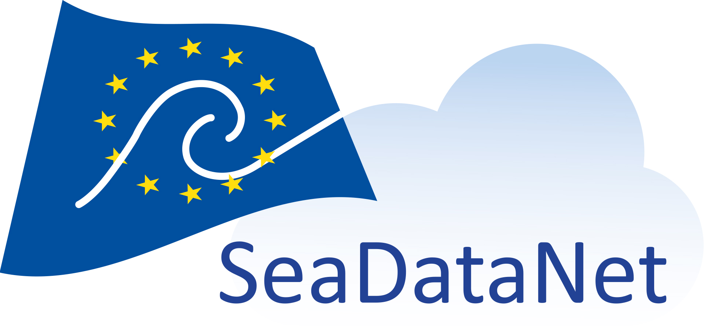
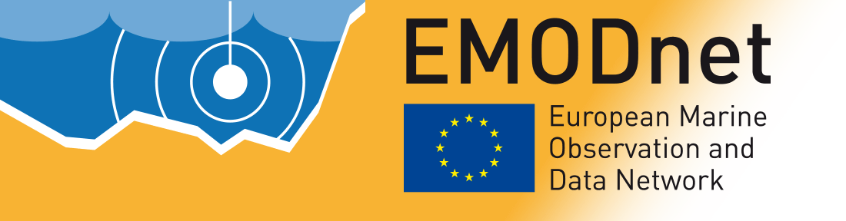



Introduction
European
SeaDataNet infrastructure
(SEA-SEARCH > SeaDataNet > SeaDataCloud)
Metadata to data to cloud
Linkage with other European data infrastructures e.g. EMODnet, Copernicus Marine Environment Monitoring System (CMEMS), EuroGOOS
Global
IOC/IODE – ICES – IHO – WMO – ISC - RDA

Slide 3
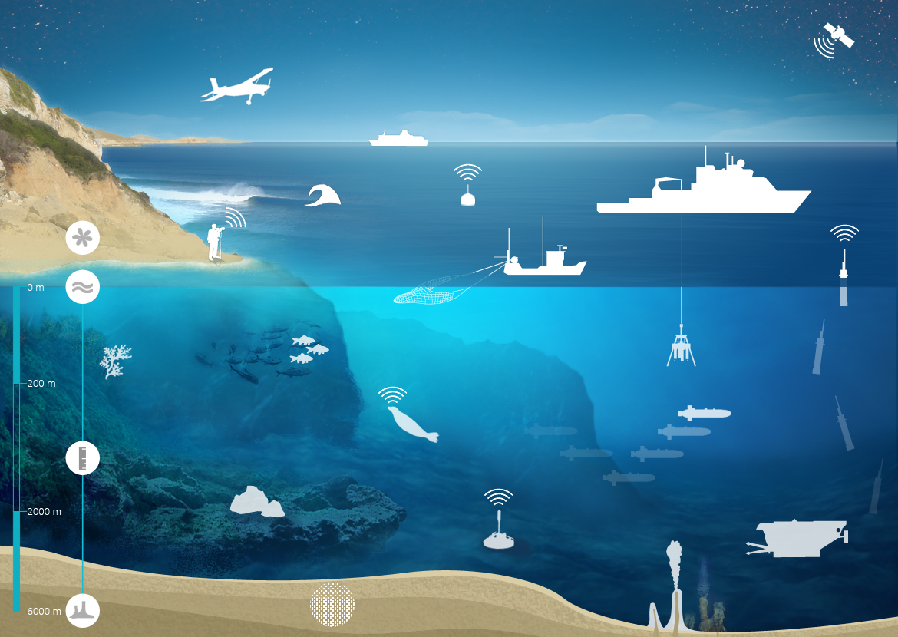
Acquisition of marine data
Satellites
Planes
Commercial ships
Fixed buoys
Oceanographic vessels
HF Radar
Profilers
Surface
Fishing vessels
Sea elephants
Gliders
Water column
Sea –floor observatories
Sea bottom
Submarines
3/37

Slide 4
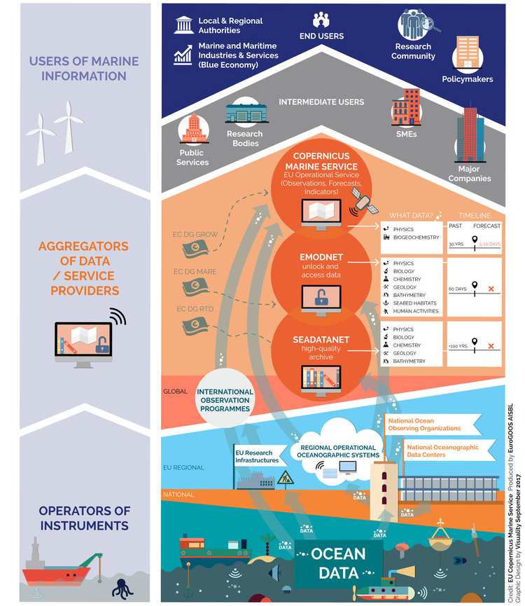
European marine landscape

Slide 5
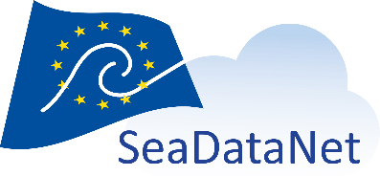
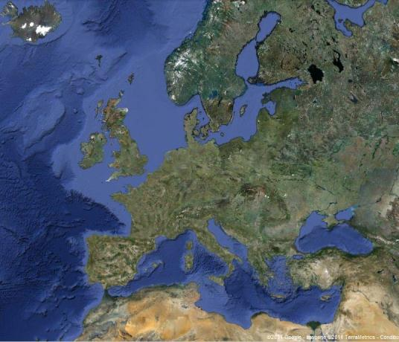
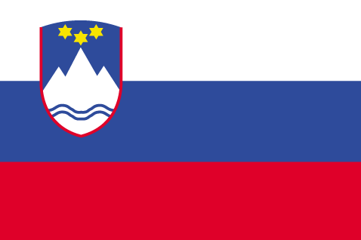
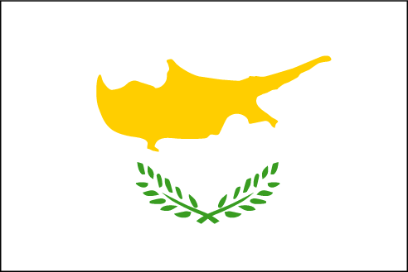

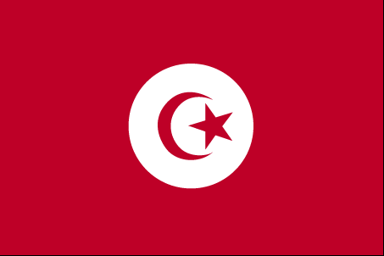
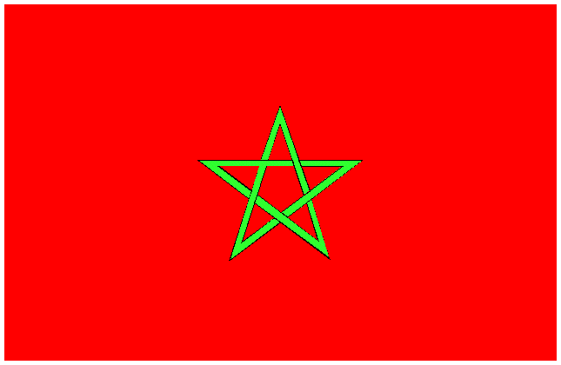
SeaDataNet
A pan-European infrastructure set up and operated for managing marine and ocean data in co-operation with National Oceanographic Data Centres and oceanographic data focal points from 35 countries bordering European seas
1990s | Metadata directories, MEDAR/ MedAtlas
2002-05 | SEA-SEARCH
2006-11 | SeaDataNet
2011-15 | SeaDataNet II
2016-20

Slide 6
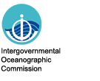
SeaDataNet partners and involvement
SeaDataNet core partners are the National Oceanographic Data Centres (NODCs), major marine research institutes (RIs) in Europe and EU Joint Research Centre (JRC)
Members have institute and national tasks for marine data management, dealing with data as collected through scientific cruises with research vessels and collected by various other platforms. Emphasis is on-situ data (delayed mode) and providing validation and long term stewardship
NODC members also participating in International Oceanographic Data and Information Exchange (IODE) programme of the Intergovernmental Oceanographic Commission of UNESCO (IOC-IODE) and in the Data Management Workgroup of the International Council for the Exploration of the Sea (ICES), discussing marine data management topics on an international basis.

Slide 7


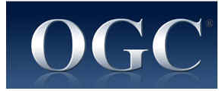
SeaDataNet standards
Set of common standards for the marine domain, adapting ISO and OGC standards and achieving INSPIRE compliance
  Adoption of ISO 19115 – 19139 standard for describing metadata on data, data sets, research cruises, monitoring networks, and research projects => marine metadata profiles, schemas, schematron rules
  Controlled vocabularies for the marine domain (>84,000 terms in 111 lists), with international governance and web services
  Standard data exchange formats : ODV ASCII and NetCDF (CF) and MedAtlas ASCII fully supported by controlled vocabularies
Maintenance and dissemination of standard QA-QC procedures, together with IOC/IODE and ICES (QC-loop)

Slide 8
SeaDataNet principles
SeaDataNet is based on a semi-distributed system (centralised metadata catalogues and distributed data), relying on the existing data centre network
The SeaDataNet RI enables a user to see the data from all the data centres connected as a virtual unique data centre, delivering integrated data, metadata and products
SeaDataCloud – aligning with the European Open Science Cloud (EOSC) vision…

Slide 9
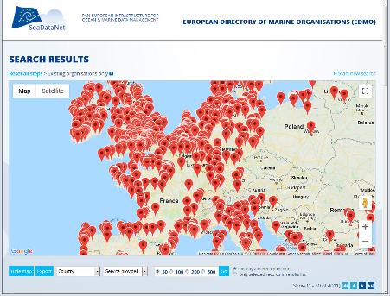
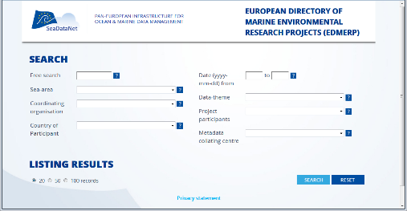
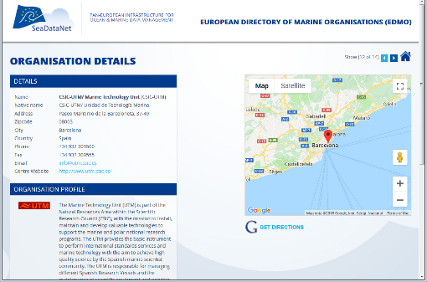
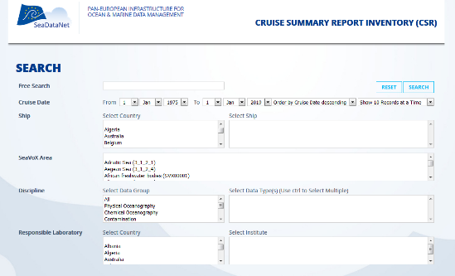
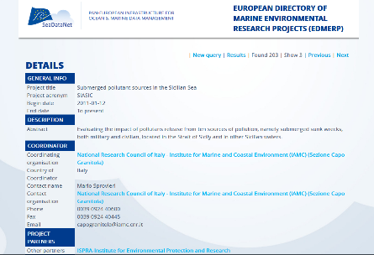
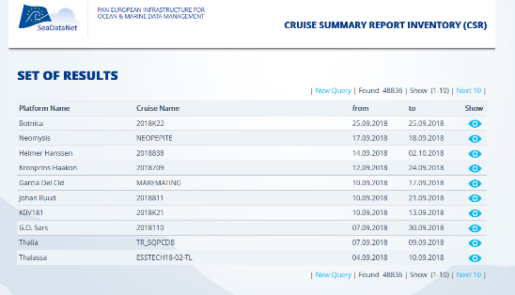
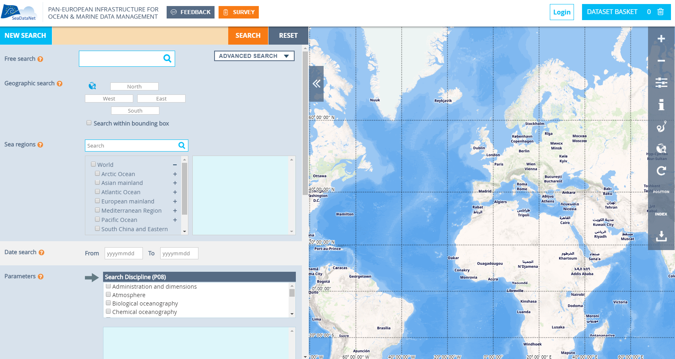
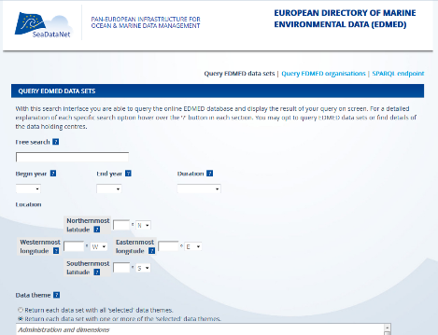
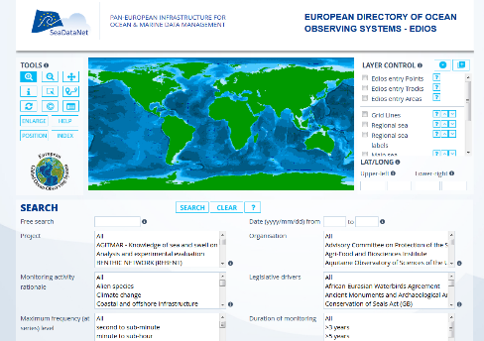
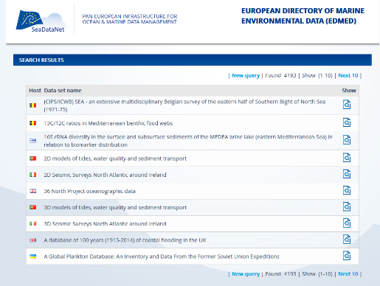
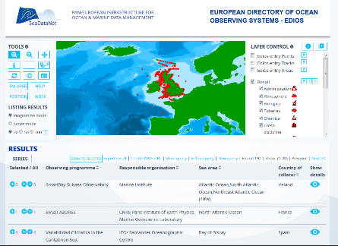
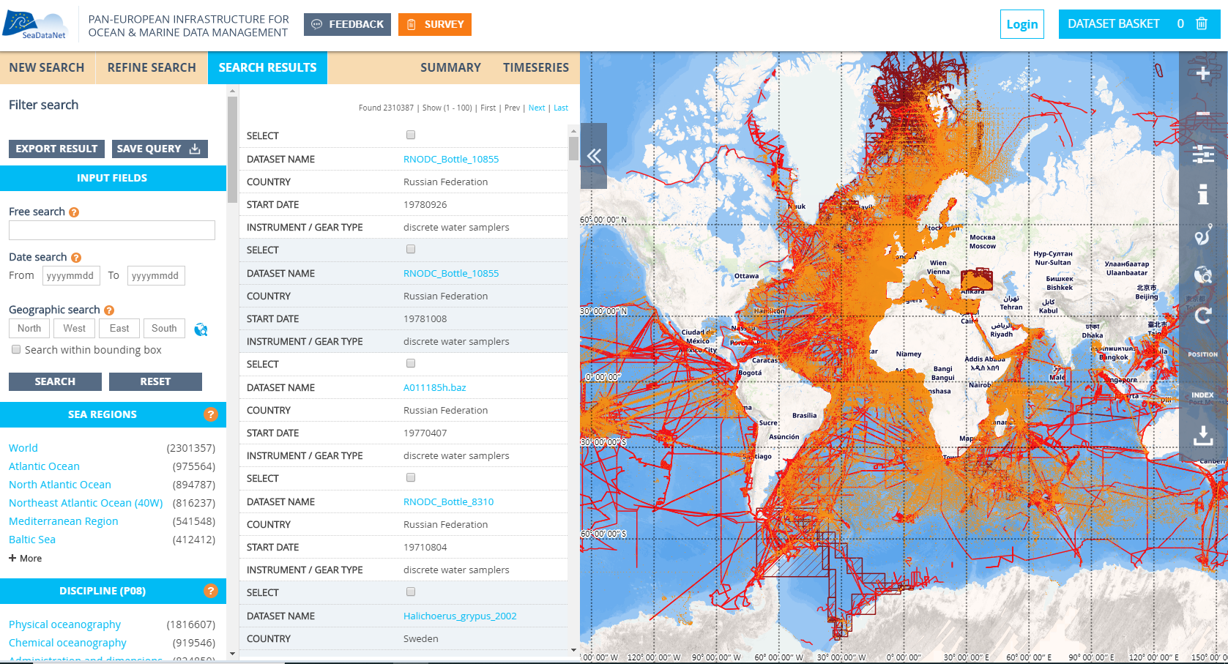
Centralised SeaDataNet metadata directories
EDMERP
EDMO
Projects (3 105)
Organisations (4 068)
CSR
Research cruises (56 694)
EDIOS
EDMED
CDI
Data sets (4 187)
Observing programmes (363)
Data index (2 276 264)

Slide 10
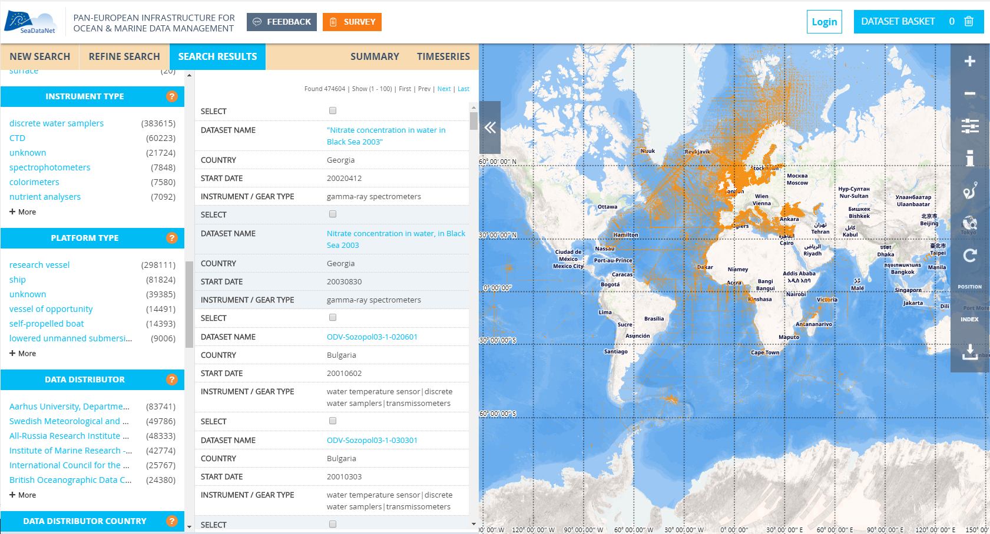
CDI (Common Data Index) Service

Slide 11
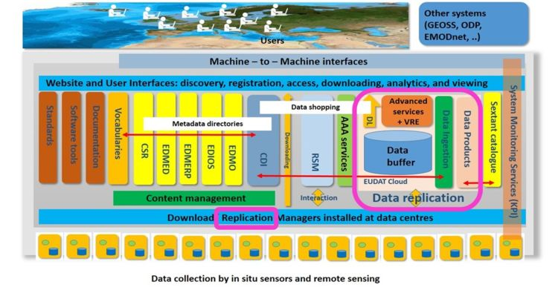

Slide 12
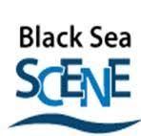
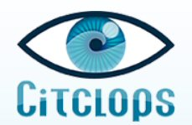
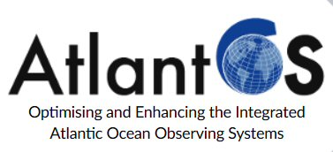
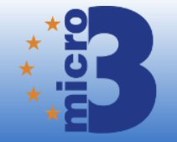

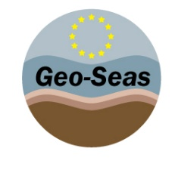

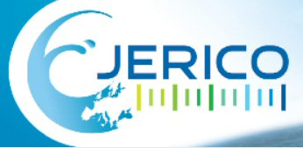
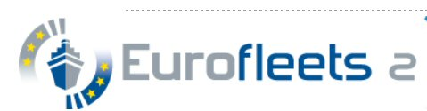
SeaDataNet partners in many projects
SeaDataNet members are participating in many EU projects in which the SeaDataNet infrastructure and standards are adopted and further developed

Slide 13
SeaDataNet cooperation
Copernicus Marine Environmental Monitoring Services (CMEMS): providing long-term archives and data management standards. MoU describing cooperation and synergy options, in particular with CMEMS-INSTAC.
Marine Strategy Framework Directive (MSFD): providing infrastructure, standards and data collections for several indicators
Large ocean monitoring systems (EuroGOOS, AtlantOS, Euro-ARGO, JERICO-Next, ..): providing standards and validation + long-term archiving services as integrator
Ocean Data Interoperability Platform (ODIP): exploring and demonstrating common standards and interoperability with leading data management infrastructures in USA and Australia
GEOSS - EuroGEOSS: Serving the GEOSS portal with SeaDataNet in-situ data collections from large community of European data holders (> 100 data centres; >600 data originators)
European Open Science Cloud (EOSC): shaping the pilot Blue Cloud

Slide 14
Initiative of EU DG MARE, driven by Marine Knowledge 2020 Strategy and Blue Growth
A network of organisations supported by the EU’s integrated maritime policy. Work together to observe the sea, process data to international standards and make freely available as interoperable data layers and data products
“Collect once and use many times”
SeaDataNet qualified as a leading infrastructure for the EMODnet data management component and is driving several thematic portals from the start in 2008

Slide 15
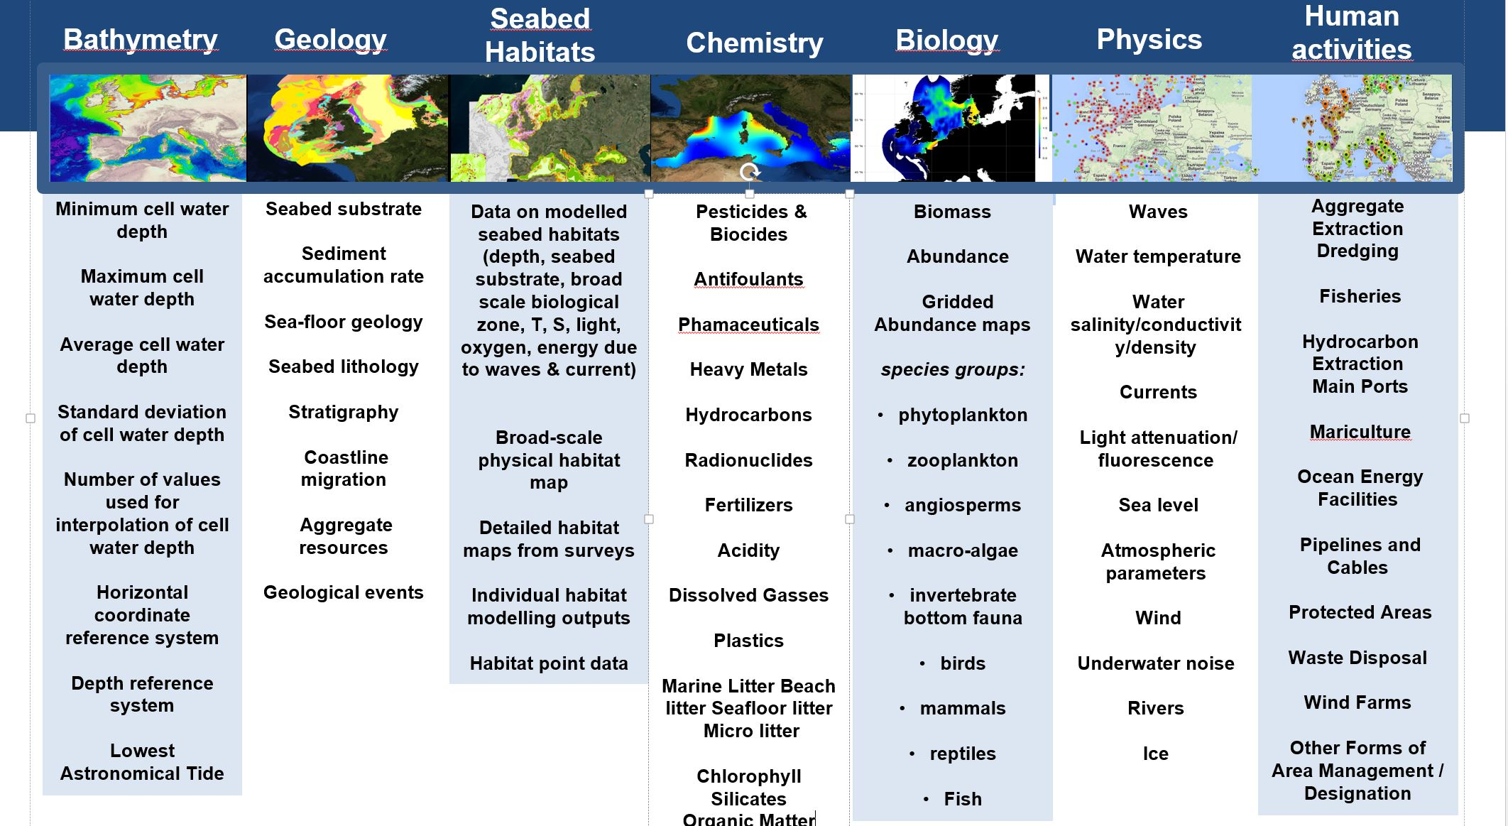
EMODnet thematic portals

Slide 16
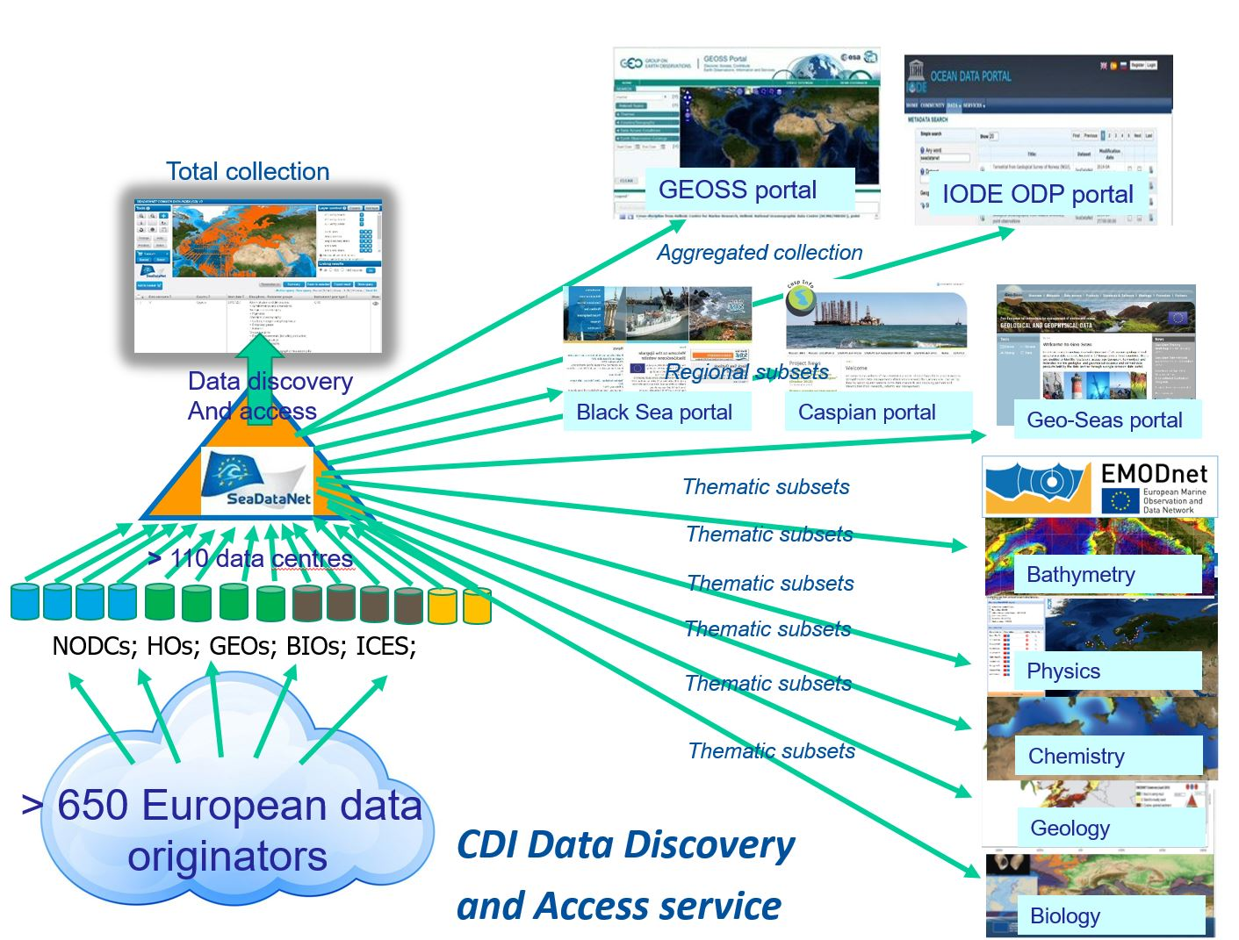
CDI service as driver for portals

Slide 17
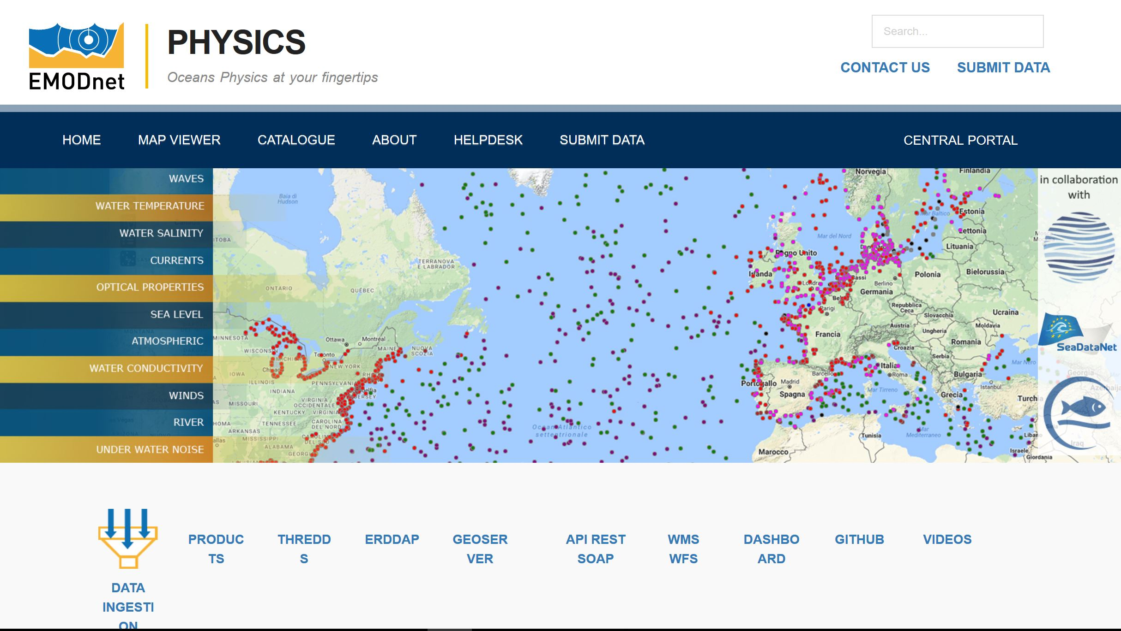
EMODnet Physics

Slide 18
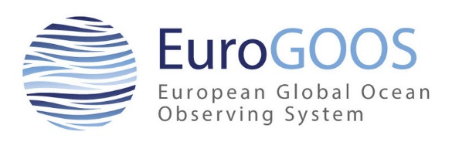
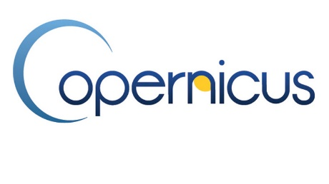
Pillars under EMODnet Physics
European Global Ocean Observing System
Association of agencies to further develop operational oceanography in European Sea areas and adjacent oceans
Component Regional Ocean Observing Systems (ROOSs) responsible for collection of in situ data.
Copernicus Marine Environment Monitoring System (CMEMS)
Operational service responding to emerging issues in environmental, business and scientific sectors.
Analyses and forecasting using satellite/in situ observations
Operates the In Site Thematic Assembly Centre (CMEMS-INSTAC) packaging observations from EuroGOOS ROOSs into QC’d data collections - forecasting services, validation processes and downstream NRT applications.
SeaDataNet
Pan-European marine data management infrastructure and network of NODCs

Slide 19
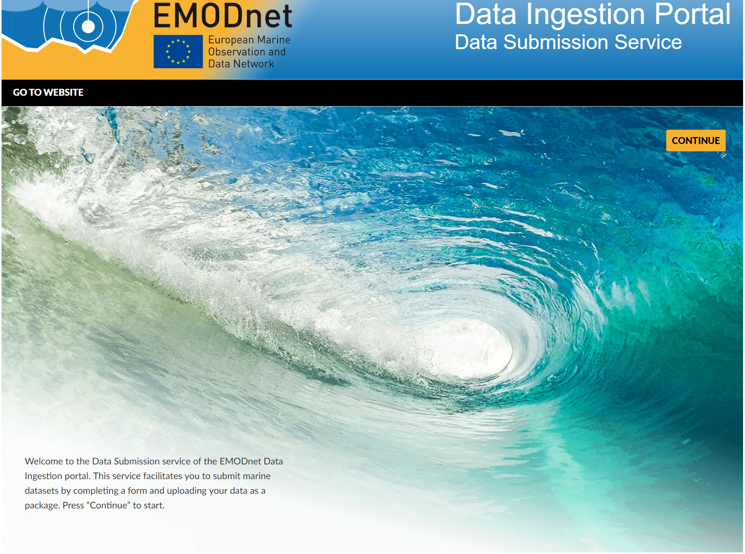

Slide 20
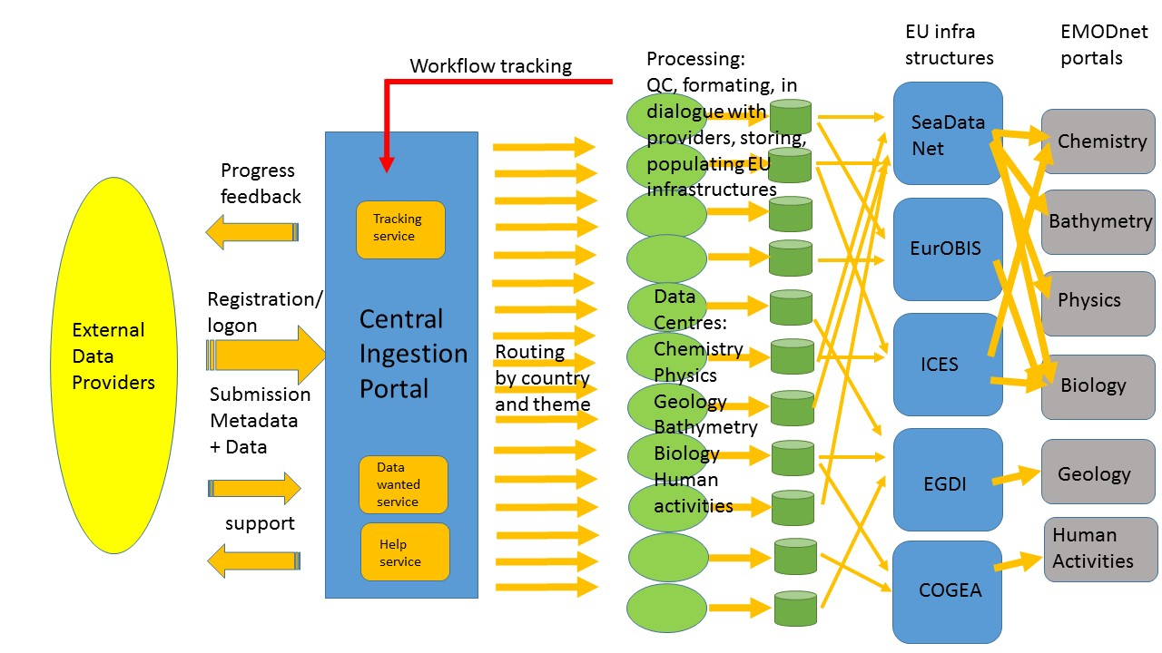
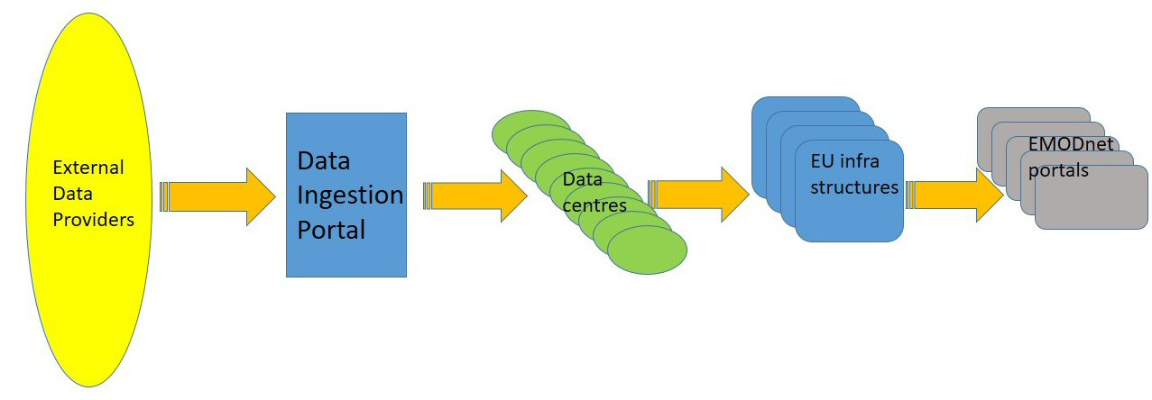
Principle data flow
Mobilise ‘sleeping’ data to serve ‘Blue Society’

Slide 21
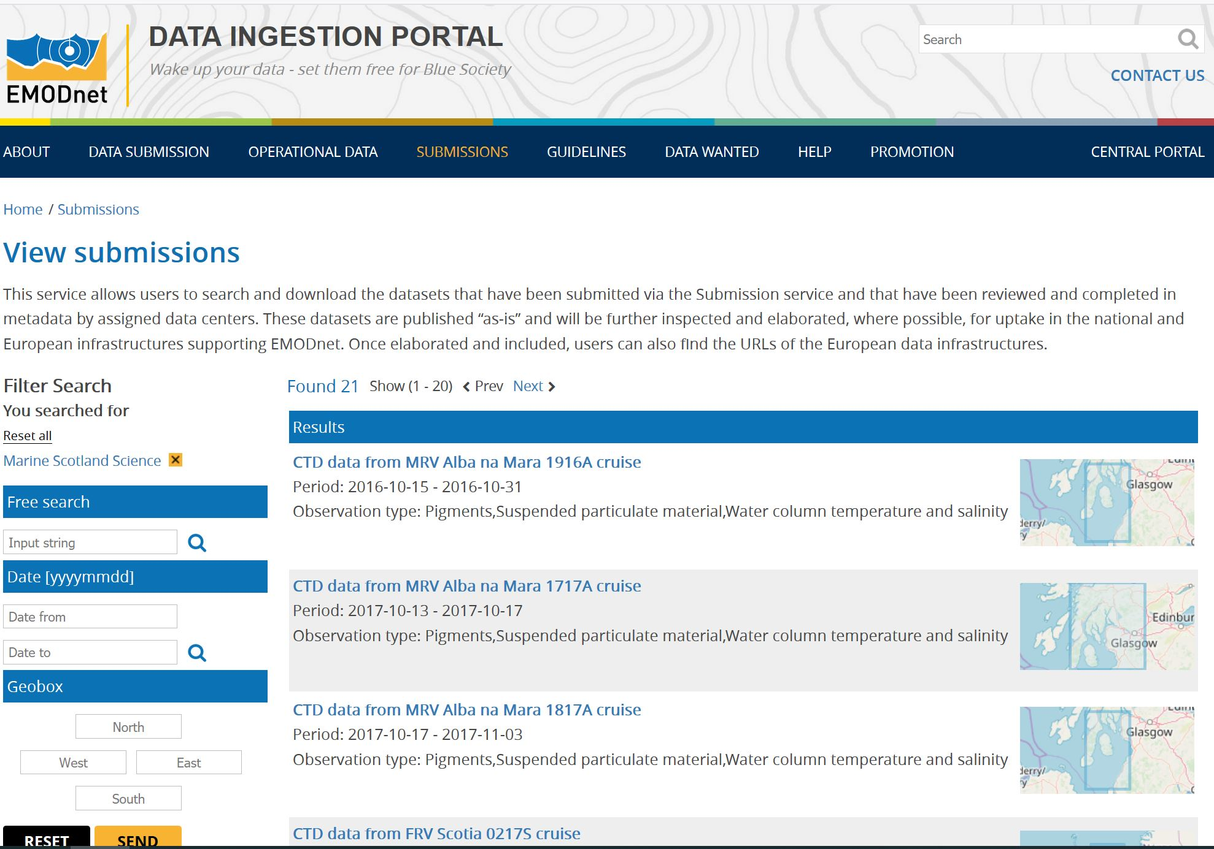
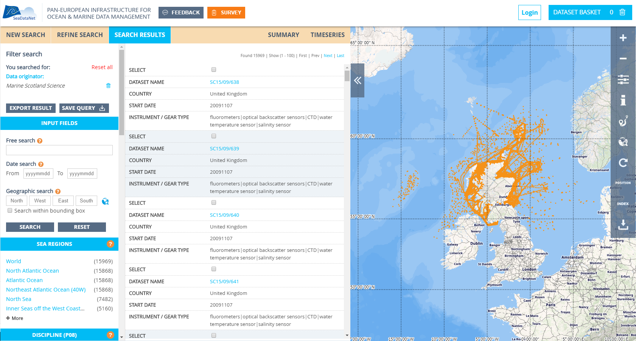
Workflow in practice…
Example:
Marine Scotland
Science cruises:
Data now in
SeaDataNet,
feeding EMODnet

Slide 22
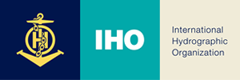


International/Intergovernmental Organisations
Intergovernmental Oceanographic Commission
International Council for the Exploration of the Sea

Slide 23
International/Intergovernmental Organisations
Intergovernmental Oceanographic Commission (IOC)
International Oceanographic Data and Information Exchange (IODE)
Global Ocean Observing System (GOOS)
IOC-WMO
Joint Technical Committee on Oceanography and Marine Meteorology (JCOMM)
IOC-IHO – GEBCO
Guiding Committee
Seabed2030
International Council for the Exploration of the Sea (ICES)
Data Portals
Data and Information Group
International Science Council
World Data System (WDS) and WDS International Technology Office (ITO)
Scientific Committee on Oceanic Research (SCOR)
Scientific Committee on Antarctic Research (SCAR)
Research Data Alliance

Slide 24
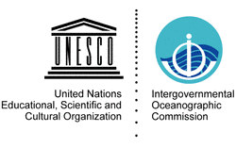
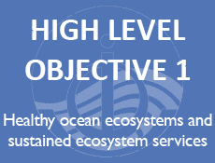
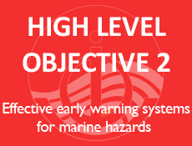
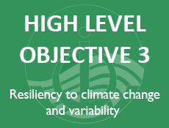
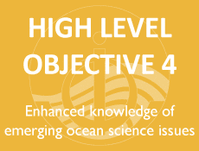
Intergovernmental Oceanographic Commission of UNESCO
  Established in 1960
  Promotes international cooperation and coordinates programmes in:
    marine research
    observation systems
    services (including data and information)
    hazard mitigation
    capacity development
  To understand and effectively manage the resources of the ocean and coastal areas
  Contributing to the UN Decade of Ocean Science for Sustainable Development (2021-2030)

Slide 25
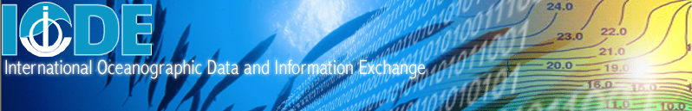


… facilitate and promote the exchange of all marine data and information…
Over 60 National Oceanographic Data Centres (NODCs)
30 Associate Data Units (ADUs)
Ocean Biogeographic Information System (OBIS)
Standards and best practices
Global data projects
Ocean Data Portal
Regional Ocean Data and Information Networks (ODINs)
Capacity Building

Slide 26
Ocean Biogeographic Information System (OBIS)
A global open-access data and information clearing-house on marine biodiversity for science, conservation and sustainable development
Emanates from the Census of Marine Life (2000-2010)
Adopted as a project under IOC-UNESCO’s IODE programme in 2009
More than 20 OBIS nodes around the world connect 500 institutions from 56 countries
Provided over 58 million observations of nearly 130 000 marine species, from Bacteria to Whales, from the surface to 10 900 meters depth, and from the Tropics to the Poles.
Datasets are integrated so you can search and map them all seamlessly by species name, higher taxonomic level, geographic area, depth, time and environmental parameters

Slide 27






Global Ocean Observing System

Slide 28


Slide 29





General Bathymetric Chart of the Ocean (GEBCO)
Aims to provide the most authoritative, publicly available bathymetry data sets for the world’s oceans
Initiated in 1903 - First Edition published in 1905
Now under the joint auspices of IHO and IOC
Seabed2030 – funding from Nippon Foundation
Aims to bring together all available bathymetric data to produce the definitive map of the world ocean floor by 2030 and make it available to all

Slide 30

International Council for the Exploration of the Sea (ICES)
Intergovernmental marine science organization, meeting societal needs for impartial evidence on the state and sustainable use of our seas and oceans set up in 1902
Well-established data centre
Provides marine data services to ICES member countries, expert groups, HELCOM and OSPAR, EEA) and various other European projects and biodiversity portals
Large dataset collections organised around specific thematic data portals:
  Biological community
  Contaminants and biological effects
  Eggs and larvae
  Fish predation (stomach contents)
  Fish trawl survey
  Historical plankton
  Ocean physics and chemistry
Data and Information Group (DIG)

Slide 31


Interdisciplinary body of the International Science Council (ISC; formerly ICSU) created by its 29th General Assembly in Maputo, Mozambique in 2008
Enabling universal and equitable access to quality-assured scientific data, data services, products and information
Supported by:
  International Project Office in Tokyo
  International Technology Office in Canada
123 member organisations, including IODE

Slide 32
The Research Data Alliance (RDA) builds the social and technical bridges that enable open sharing of data
The RDA vision is researchers and innovators openly sharing data across technologies, disciplines, and countries to address the grand challenges of society – membership ~10,000
Major funding for RDA is provided by the following organisations:
  The Australian Commonwealth Government through the Australian National Data Service
  European Commission’s 7th Framework Programme through the RDA Europe project
  The National Science Foundation
Currently working through 66 Interest Groups and 36 Working Groups, e.g.:
  Metadata – FAIR – PIDs – Data Publication
  Active Data Management Plans
  Vocabulary services (VSSIG)
  InteroperAble Descriptions of Observable Property Terminology WG
  Persistent Identification of Instruments
  Certification of Digital Repositories
  …

