Slide 1
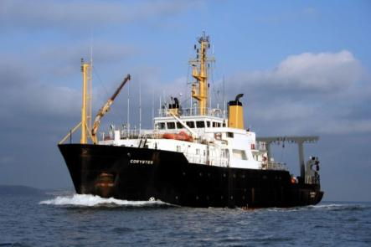
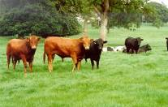
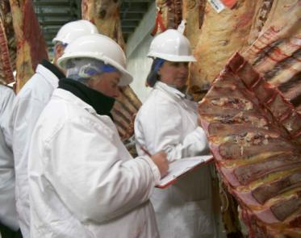
AFBI – Progress Through Research and Innovation Dr Sinclair Mayne 1 June, 2017
Notes:
Note: Do not change background, font or font colours.

Slide 2
Overview
Global and local challenges for the agri-food sector
Key Achievements:
- Science outcomes
- Funding
Partnerships
Future

Slide 3
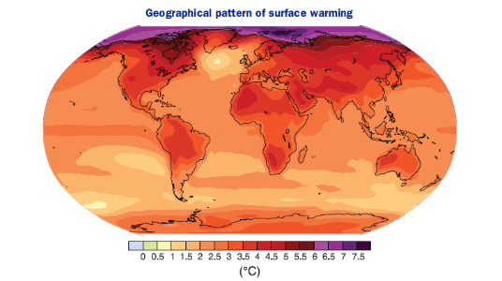
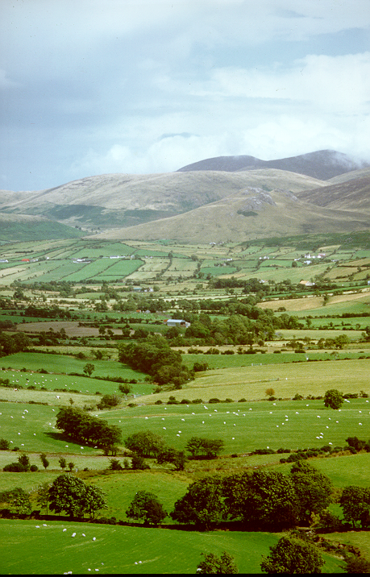
Global and Local Challenges
Major global issues include:
- Population growth and dietary shifts.
(Global dairy demand increasing from
580 mt–1043 mt by 2050 FAO, 2009)
Climate change
Pace of scientific and technological change.
Brexit and implications for UK agri-food.
By 2050, we need to double food supply from less land than is available today, with less fertilisers and pesticides and lower GHG emissions.

Slide 4
Global and Local Challenges – AFBI’s Role
AFBI needs to lead the way in understanding and interpreting how global changes impact on the agri-food sector.
Science is essential to:
- Protect animal and plant health status in Northern Ireland
- Enhance Northern Ireland’s high quality food reputation
- Provide the evidence base for new policy development
- Drive new knowledge, technical advances and the innovation pipeline – all of which are crucial for improved technical efficiency

Slide 5
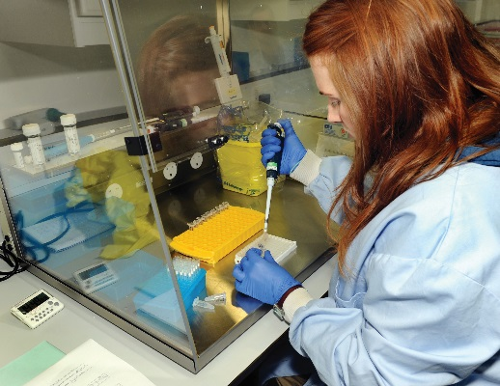
What We Do
Statutory/regulatory/diagnostic work (DAERA and commercial customers)
- Plant, tree and fish health
- Animal health testing (TB, BVD, Avian Influenza, TSE, Salmonella)
- Veterinary drug residues (UK National reference Lab – banned vet drugs)
- Marine Biotoxins (UK National reference Lab)
- Seed testing and certification
- Food testing – enhancing Northern Ireland’s food reputation
- Forage analysis via Hillsborough Feed Information Service
Monitoring (DAERA)
- Marine Fish stocks
- Aquatic and terrestrial ecosystems

Slide 6
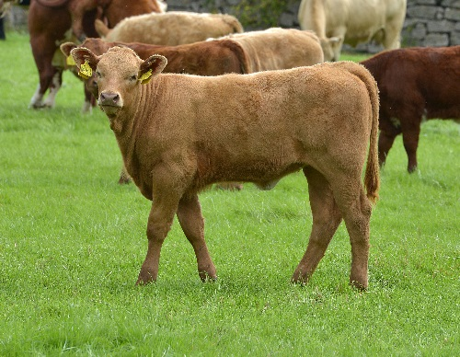
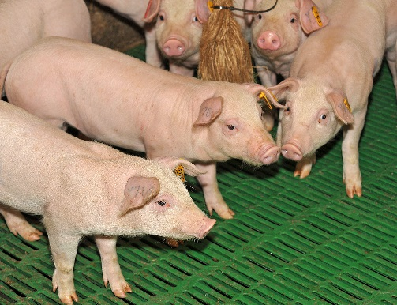
What We Do
Research and development – 63 DAERA E&I projects (with industry co-funding)
- Improve industry competitiveness and stimulate innovation
- Address policy and industry knowledge gaps
- Inform policy development
Specialist advice and emergency response.
Communicate results and achieve local industry impact

Slide 7
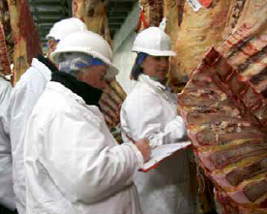
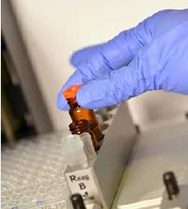
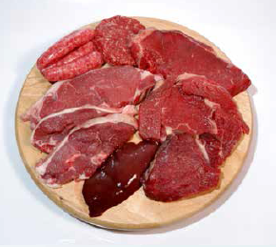
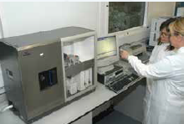
AFBI Statutory Testing Programmes
AFBI undertakes all of the statutory chemical contaminant testing of
feedstuffs and food in Northern Ireland on behalf of DAERA, FSA
and the Chemical Regulations Directorate.
Tests include: Veterinary drug residues; pesticides; marine biotoxins;
heavy metals; and mycotoxins.
Testing is undertaken on animal feedstuffs, cattle, sheep, pigs, poultry,
eggs, milk, fish and shell fish.
AFBI’s test methods are internationally accredited using state-of-the-art equipment, supported by ongoing research and development.

Slide 8
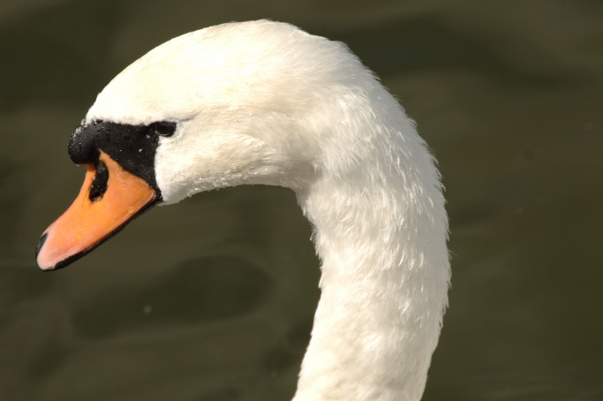
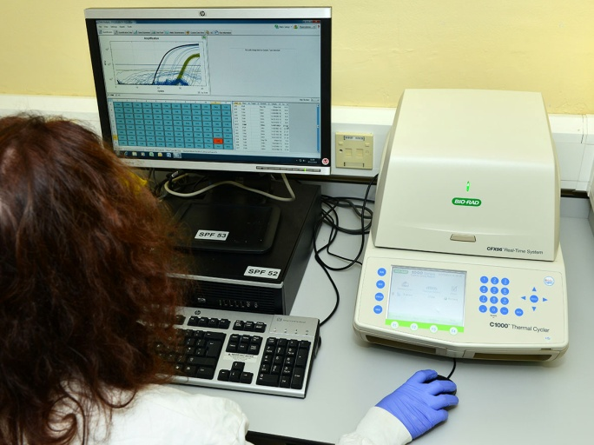
AFBI Protects Northern Ireland Animal Health
Highly pathogenic avian influenza H5N8
Following a number of outbreaks in GB and Ireland, highly pathogenic H5N8 was detected in a mute swan in early February.
Supporting BVD eradication in NI
Following the introduction of the compulsory phase of the BVD eradication program in March 2016, AFBI tested >370,000 ear tag tissue samples to April 2017.
Notes:
H5N8 is a highly pathogenic avian influenza (HPAI) subtype that first emerged across Europe and Asia in 2014, causing deaths in wild bird populations and outbreaks in domestic poultry flocks.
Although there is currently no evidence for human infection with H5N8 and the risk to people is considered low, the pandemic potential of H5 and H7 avian influenza subtypes require control measures to be implemented upon detection.
The rapid detection of HPAI by the Veterinary division at AFBI underlines the critical role played by the division in safeguarding the Northern Irish poultry industry. Four cases of H5N8 have been detected so far in Northern Ireland in 2017 and this highlights the importance of maintaining cutting edge local capabilities to respond to emerging disease threats.

Slide 9
AFBI Protects NI Plant Health
AFBI carries out routine pest and pathogen diagnosis, provides advice and delivers an emergency response capability to DAERA (e.g. the ash dieback outbreak)
AFBI scientists identify and prioritise new plant health threats. Currently over 950 insects, nematodes, bacteria, fungi and viruses are under review
Crop type | No. of samples | Important quarantine pests and pathogens tested for
Crops | >2800 | Ring rot of potato, Nematodes, Potato Spindle Tuber Viroid, Potato flea beetle, Colorado beetle.
Forest (e.g. Larch, Ash) | >800 | Ash dieback, Sudden larch death, Fireblight, Emerald ash borer
Research underpins much of the advisory and diagnostic work in AFBI Plant Health.

Slide 10
AFBI – Leads UK Analysis on Brexit
Leading the UK analysis of Brexit impacts on UK agriculture:
Unique AFBI expertise via FAPRI-UK programme; evidence base for UKAP
Implications of trade scenarios for farm commodity prices and production
Results produced at UK level and for each UK administration
Presentations to Defra, Devolved Administrations and stakeholders in coming weeks

Slide 11
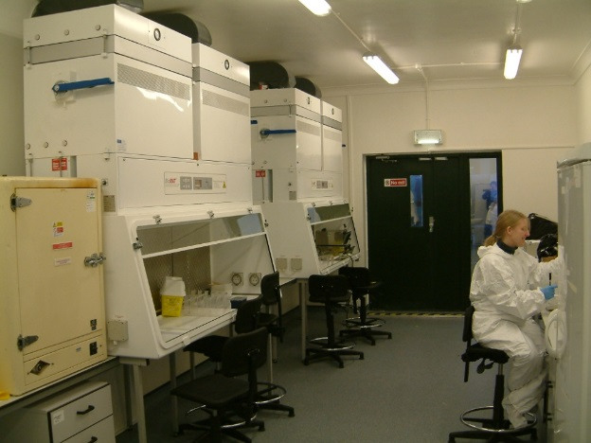
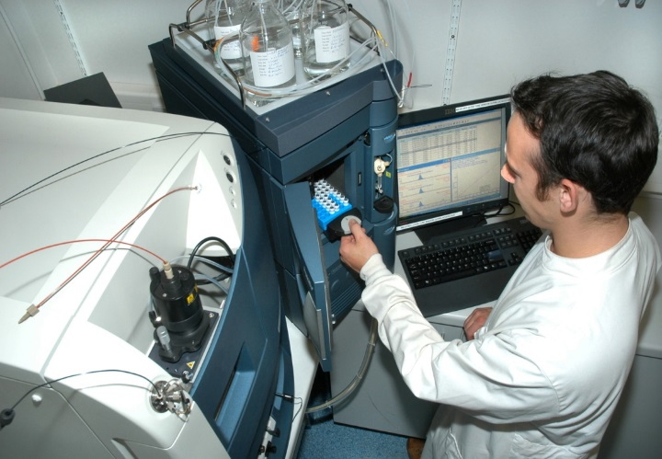
AFBI Supports Northern Ireland Agri-Food Exports
AFBI BSE testing - contribution to NI negligible risk BSE status. - BSE Negligible Risk Status for Northern Ireland (decision confirmed May 2017). AFBI testing has been a significant component of the eradication and surveillance programme for this disease in Northern Ireland.
Veterinary drug residue and chemical contaminant testing
- AFBI hosted audit visits from a number of non-EU countries (US, Australia and China) in support of securing market access for NI produce.
Notes:
In September 2016, DAERA formally applied to OIE for official recognition of BSE Negligible Risk Status for Northern Ireland (decision due end May 2017). AFBI testing has been a significant component of the eradication and surveillance programme for this disease in Northern Ireland. NI is the first of the UK regions to seek negligible risk status for BSE and has positive trade implications for the region.

Slide 12
New Research Contracts 2016/17
Successful year for INTERREG funding (7 projects worth (£12.68m)
Collaborative Action for the Natura Network (CANN) project (£650k)
Collaborative Oceanography & Monitoring for Protected Areas and SpecieS (COMPASS)(£6.3m)
Shared Waters Enhancement and Loughs Legacy (SWELL) (£1.75m)
Northern Runoffs into Profits (WaterPro)(£184k)
Catchment Community Action for Resilient Ecosystems (CatchmentCARE)(£2.9m)
Evaluating a farm incentive scheme to protect drinking water (Source-To-Tap) (£650k).
System for Bathing Water Quality Monitoring (SWIM)(£250k)

Slide 13
New Research Contracts 2016/17
Horizon 2020 – two successes (EU Pig, FAirWAY) (340k)
Agri-Food Quest Competence Centre – (5 projects, £468k)
Innovate UK (1 project £938k)
US/Ireland/N. Ireland fund – (1 project £250k)
DAFM/DAERA Co-funding – (16 projects £1.9m)
AFBI in final discussions re ‘preferred R&D provider’ to major UK retailer

Slide 14
Knowledge Exchange and Public Engagement
European Federation of Animal Science
- Over 1500 international scientists from 60 countries - provided
excellent showcase for AFBI science and established new networks
UK-ROI TB Genetics Summit
Schools Open Day at AFBI Hillsborough for GCSE & A Level students.
NI Science Festival in Dungannon, Newry, Enniskillen and Coleraine as well as an Open Farm event at AFBI Hillsborough
AFBI/LMC/CAFRE/UFU Beef Conference.
AFBI Delegation to China to build linkages and projects in tandem with Innovate UK.
AFBI/Teagasc/USDA/Genome Canada Forum in Edmonton – Nov 2016
AFBI Science Outlook Conference March, 2017
Science Uncovered- an EU Researchers event organised by Ulster Museum
RUAS events: Balmoral Show and Winter Fair

Slide 15
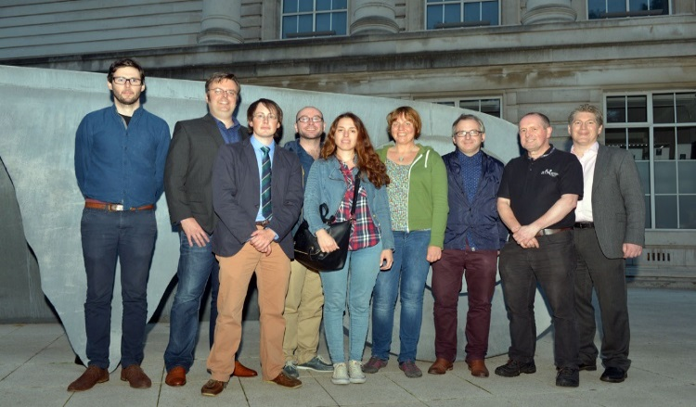
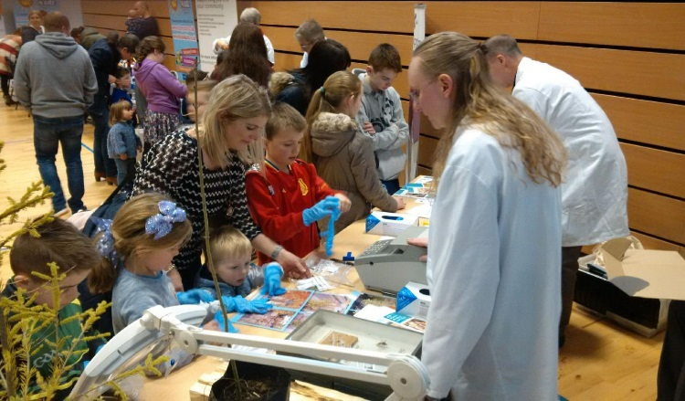
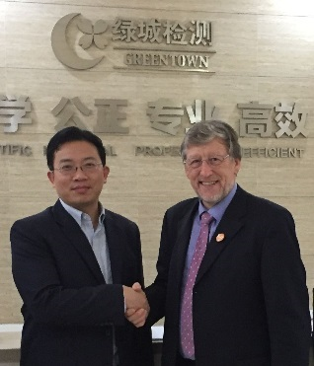
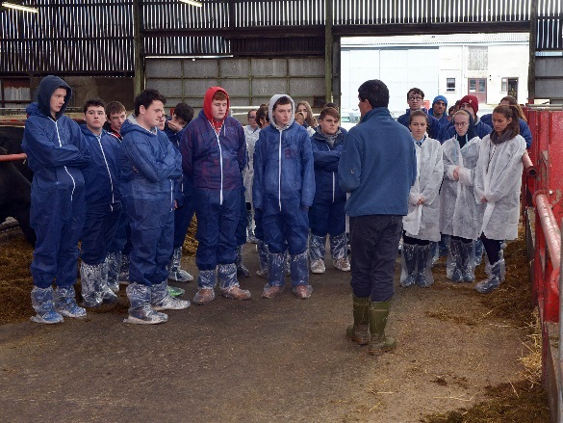
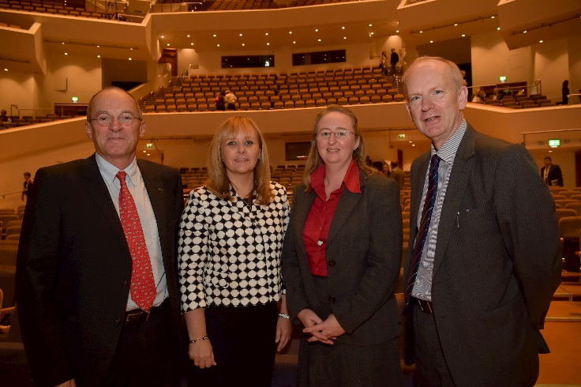
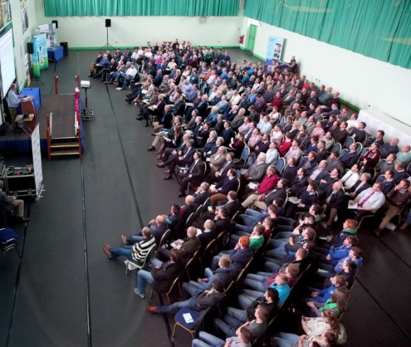
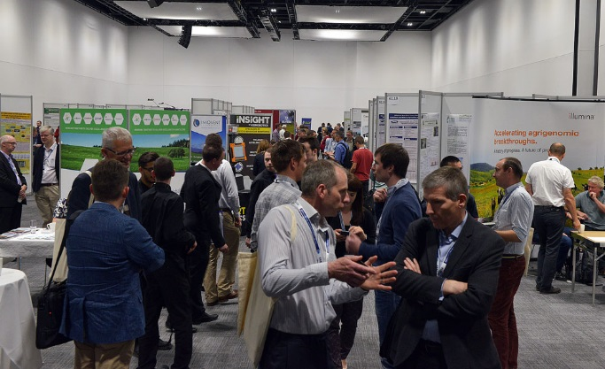
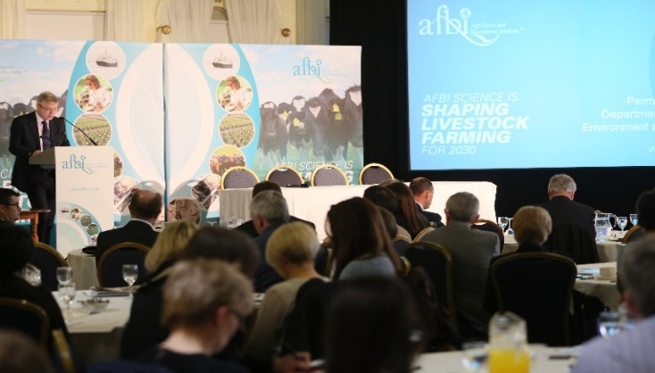
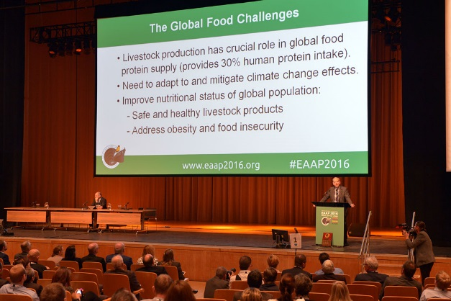
AFBI Events/Activities

Slide 16
DAERA Grant in Aid 2006/07 to 2017/18 (£’000)

Slide 17
AFBI Non-GIA Income 2006/07 to 2017/18 (£’000)

Slide 18
Research Partners And Funders
SiSaf
Pig Regen Ltd

Slide 19
The Future
Increased focus on working with industry to ensure AFBI science drives competitiveness and innovation, improves the environment and stimulates the wider rural economy.
Greater focus on strategic planning of AFBI’s science programme - an integrated platform for multidisciplinary and interdisciplinary research in agri-food and biosciences.
Flexible programme-based approach which evolves and adapts to changing priorities and funding streams.
Reduced number of core scientific programmes in which AFBI makes an impact both nationally and internationally.

Slide 20
UK and Ireland Research Links
Roslin Institute
SRUC
Uni of Newcastle
UU
QUB
Teagasc
Grange (Beef)
Uni of Leeds
Teagasc
Oldpark (Genomics)
UCD
IBERS
Uni of Nottingham
Harper Adams
Teagasc
Moorepark (Dairy)
Rothamstead Research
UCC
Royal Veterinary College
Uni of Bristol
Duchy College

Slide 21
Worldwide Research Links
Aarhus Universitet
Theunen-Institut
ZLTO
Dalhousie Uni
IFREMER
Wageningen Uni
Genome Canada
INRA
Universitaet Wien
Chinese Academy of Agricultural Sciences
USDA ARS
CRSPA SPA
AZTI Fundazioa
Shanghai Academy of Agricultural Sciences
Uni of Western Australia
Massey Uni
Dept of Agriculture
Falkland Islands
Lincoln Uni

