Slide 1



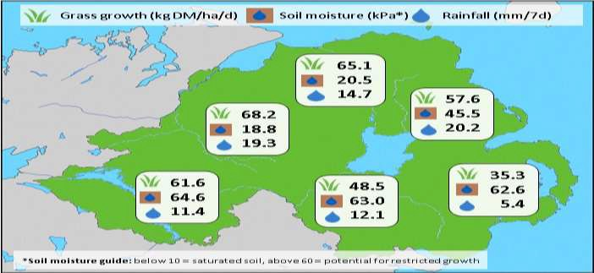
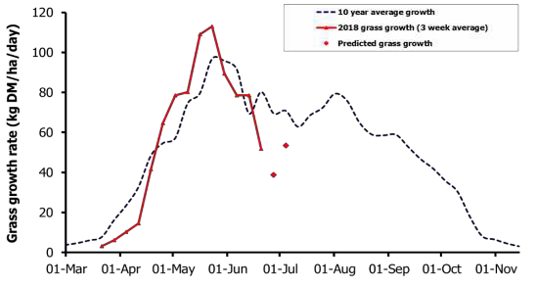



Week Beginning 25 June 2018
MANAGEMENT NOTES:
For the third week in a row there is large variation in growth across the province with a range of growth rates from 8.4 to 122kg DM/ha/day with south east areas still experiencing drought conditions.
On farms where growth is restricted increasing concentrate supplementation, particularly for dairy cows and finishing beef will be key to maintaining animal performance. Alternatively, buffer feeding forage or bringing in additional grazing area will help extend the rotation for the coming few weeks.
For all grazing stock, water is essential in the current conditions to maintain performance and reduce heat stress. Daily water intake can be as high as 150 litres per dairy cow, 50 litres per suckler cow and 10 litres per ewe with lambs. Ensure troughs are freely available with sufficient capacity to meet peak demand.
Weekly Grass Growth (kg DM/ha/day)
GrassCheck plots |  | 51.8
Dairy farms* |  | 58.6
Beef & sheep farms* |  | 49.3
Forecast | 7 day | 38.8
 | 14 day | 53.4
Grass Quality Plots On-farm
DM (%) | 26.3 | 17.9
ME (MJ/kg DM) | 11.3 | 11.4
CP (% DM) | 14.8 | 18.9
WSC (% DM) | 16.6 | 13.1
*On-farm grass growth data supplied by AgriNet
# GrassCheck plots receive 270 kgN/ha/year
@GrassCheck

