Slide 1
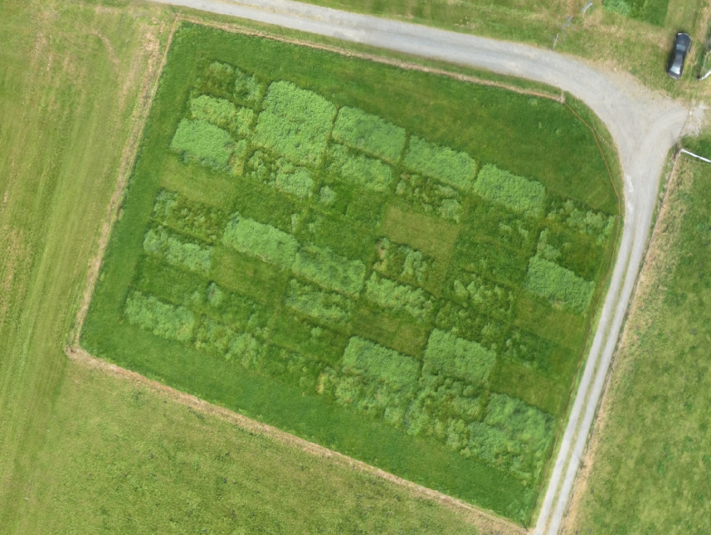
Long-term effects of nutrient fertilization on grassland
Field experiment established in 1970 to measure long-term changes in plant biomass production and soil biogeochemistry
Treatments: Control, NPK, pig slurry at 50, 100 or 200 m³ ha⁻¹ year⁻¹ & cow slurry at 50, 100, or 200 m³ ha⁻¹ year⁻¹
8 treatments x 6 replicates = 48 plots in a randomised block design
Nutrients applied in 3 equal dressings each year
Herbage cut 3 times at the silage stage
Annual soil samples collected at 3 depths
Research topics:
Plant biomass production & silage quality
Plant species diversity & composition
Soil nutrient cycling & storage
Soil carbon sequestration
GHG emissions
Soil microbiology
A unique long-term study which provides valuable data for scientific and policy purposes

